Slide 1
PETROPHYSICS SOFTWARE WORKFLOW

Slide 2
TABLE OF CONTENTS
IMPORT LOGS/DATASETS
QC LOGS
PLOT LOGS
HCDP
NEW ZONATION
VSHALE ESTIMATION
POROSITY ESTIMATION
PERMEABILITY ESTIMATION
SATURATION ESTIMATION
SATURATION HEIGHT MODELING
SUMMARIES
EXPORT

Slide 3
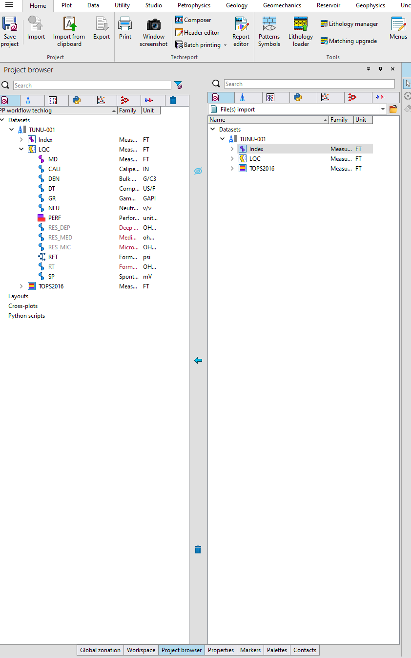
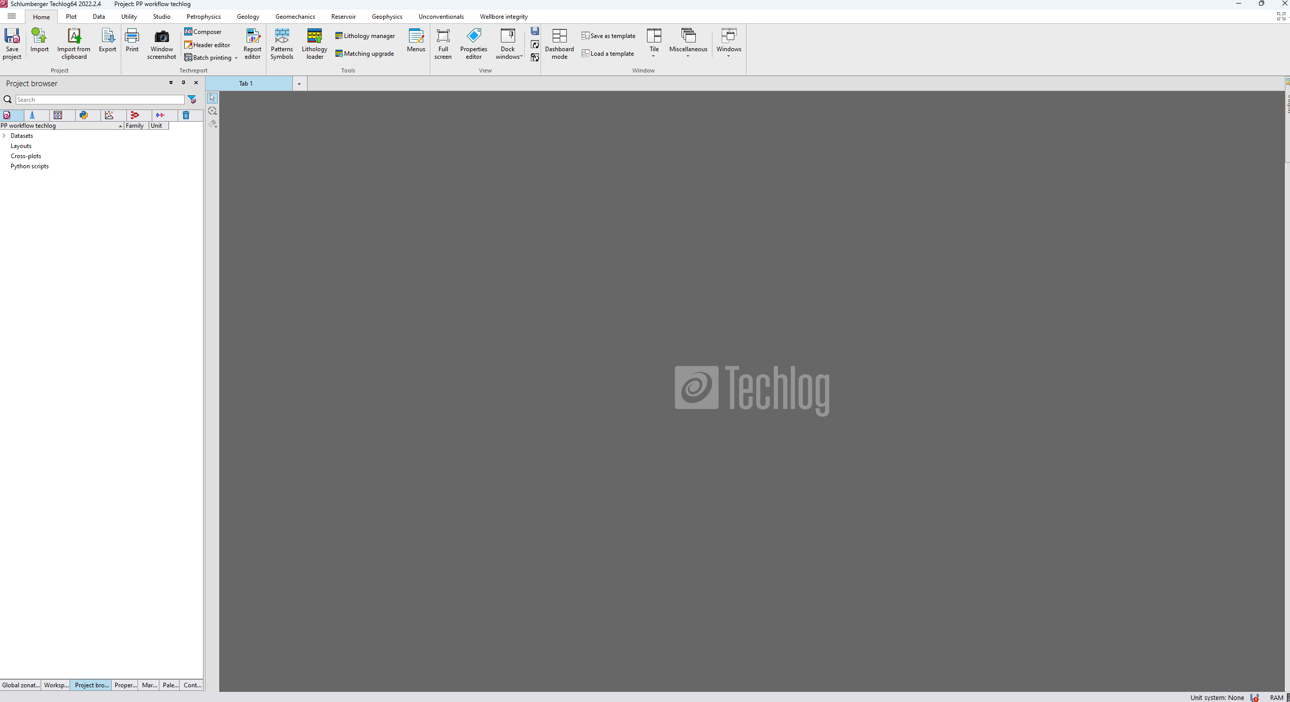
IMPORT LOGS/DATASETS
THIS OPENS THE IMPORT WINDOW
ON THE HOME TAB, CLICK ON IMPORT
BROWSE AND SELECT LOGS FROM FILES
DATASET LOADS UP LIKE SO. SELECT THE DATASETS AND CLICK ON THE “ARROW” TO IMPORT TO PROJECT
DATASET LOADS UP LIKE SO ON THE PROJECT BROWSER
CLICK ON THE “EYE-LIKE” ICON TO CLOSE THE IMPORT WINDOW WHEN DONE IMPORTING
TO DELETE A DATASET, SELECT ON IT AND CLICK ON THE “TRASH” ICON

Slide 4
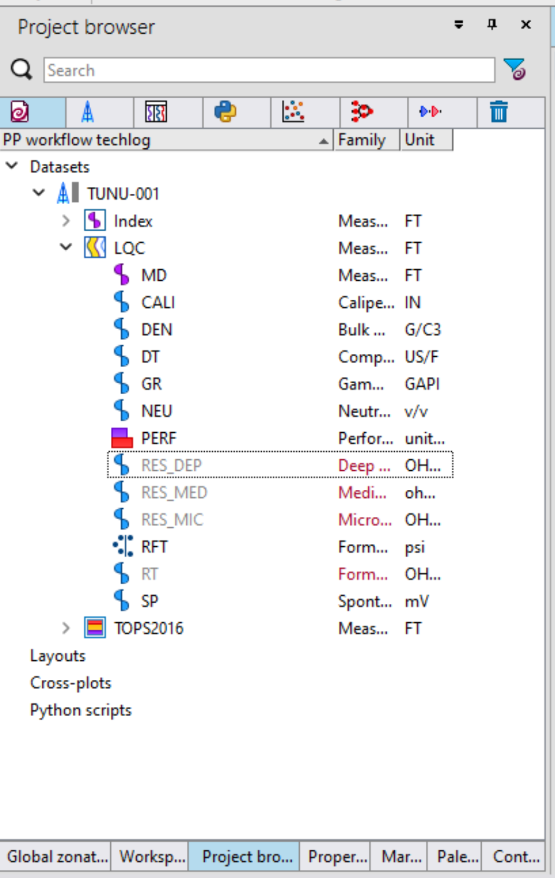
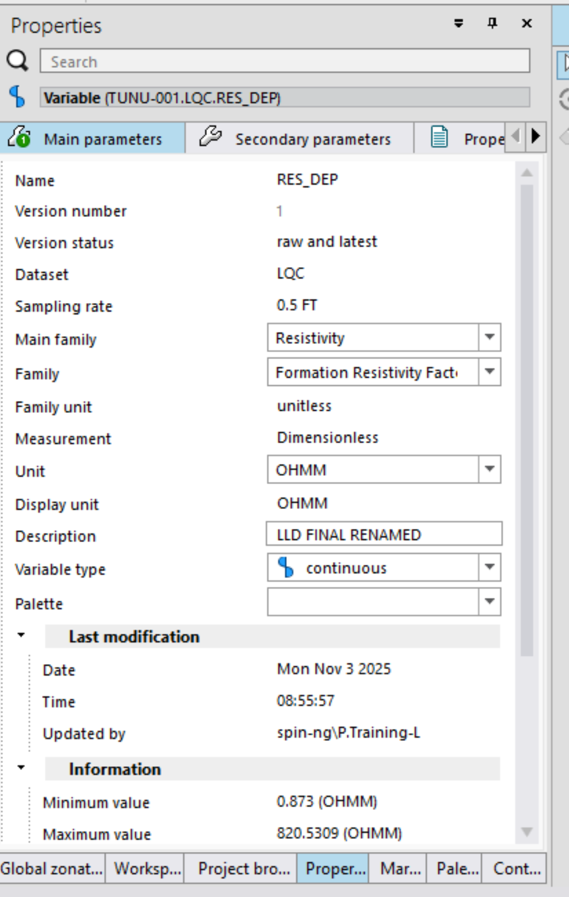
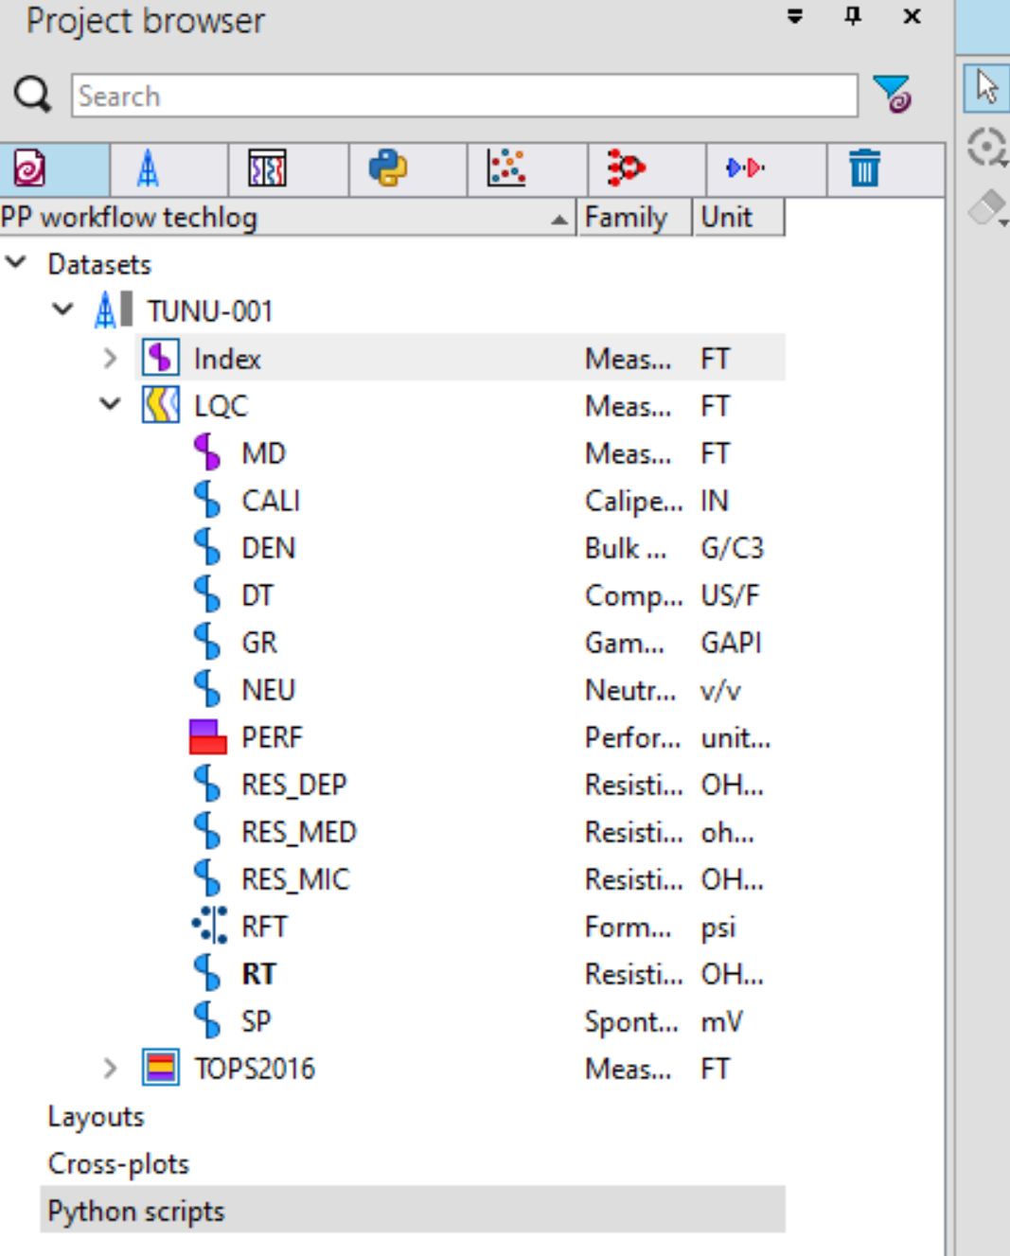
QC LOGS
ON THE PROPERTIES WINDOW, SELECT THE APPROPRIATE FAMILIES FOR EACH LOG AND THEY SHOULD DISPLAY PROPERLY ON THE PROJECT BROWSER
LOGS WITH SUCH APPEARANCE MEAN THE PARAMETERS WERE NOT CORRECTLY LOADED
SELECT SUCH LOGS AND CLICK ON THE PROPERTIES PANE

Slide 5
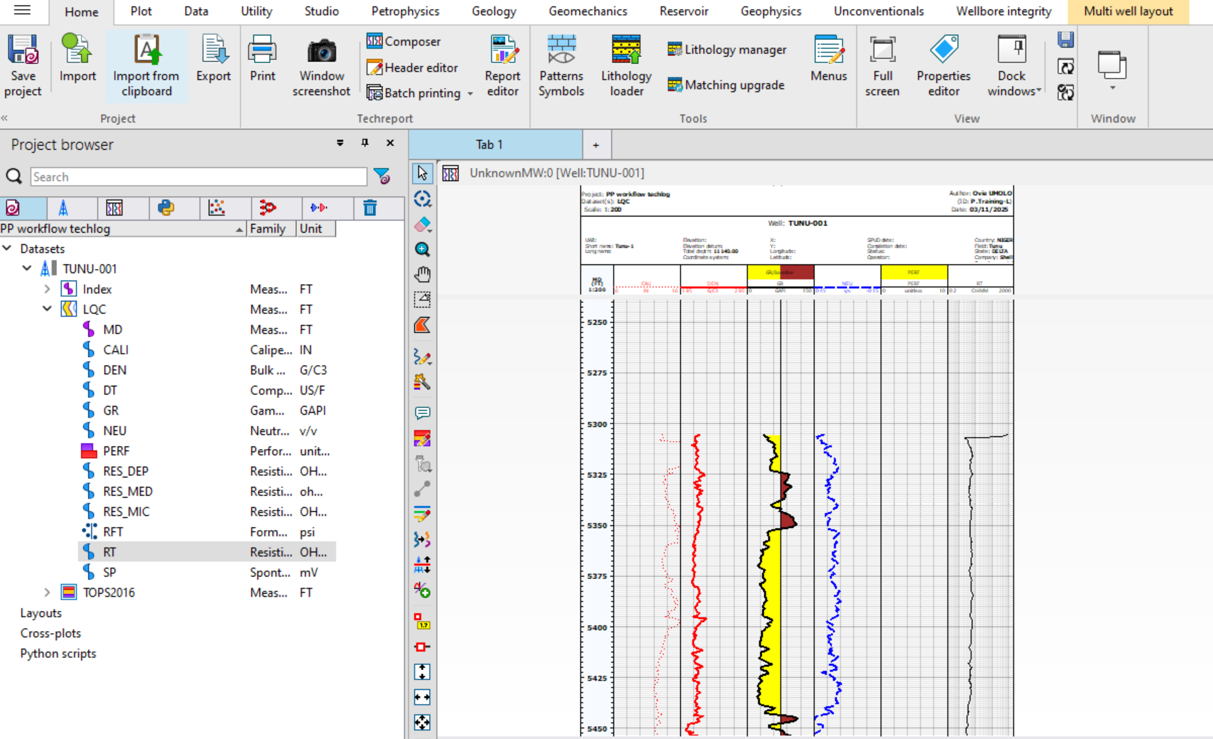
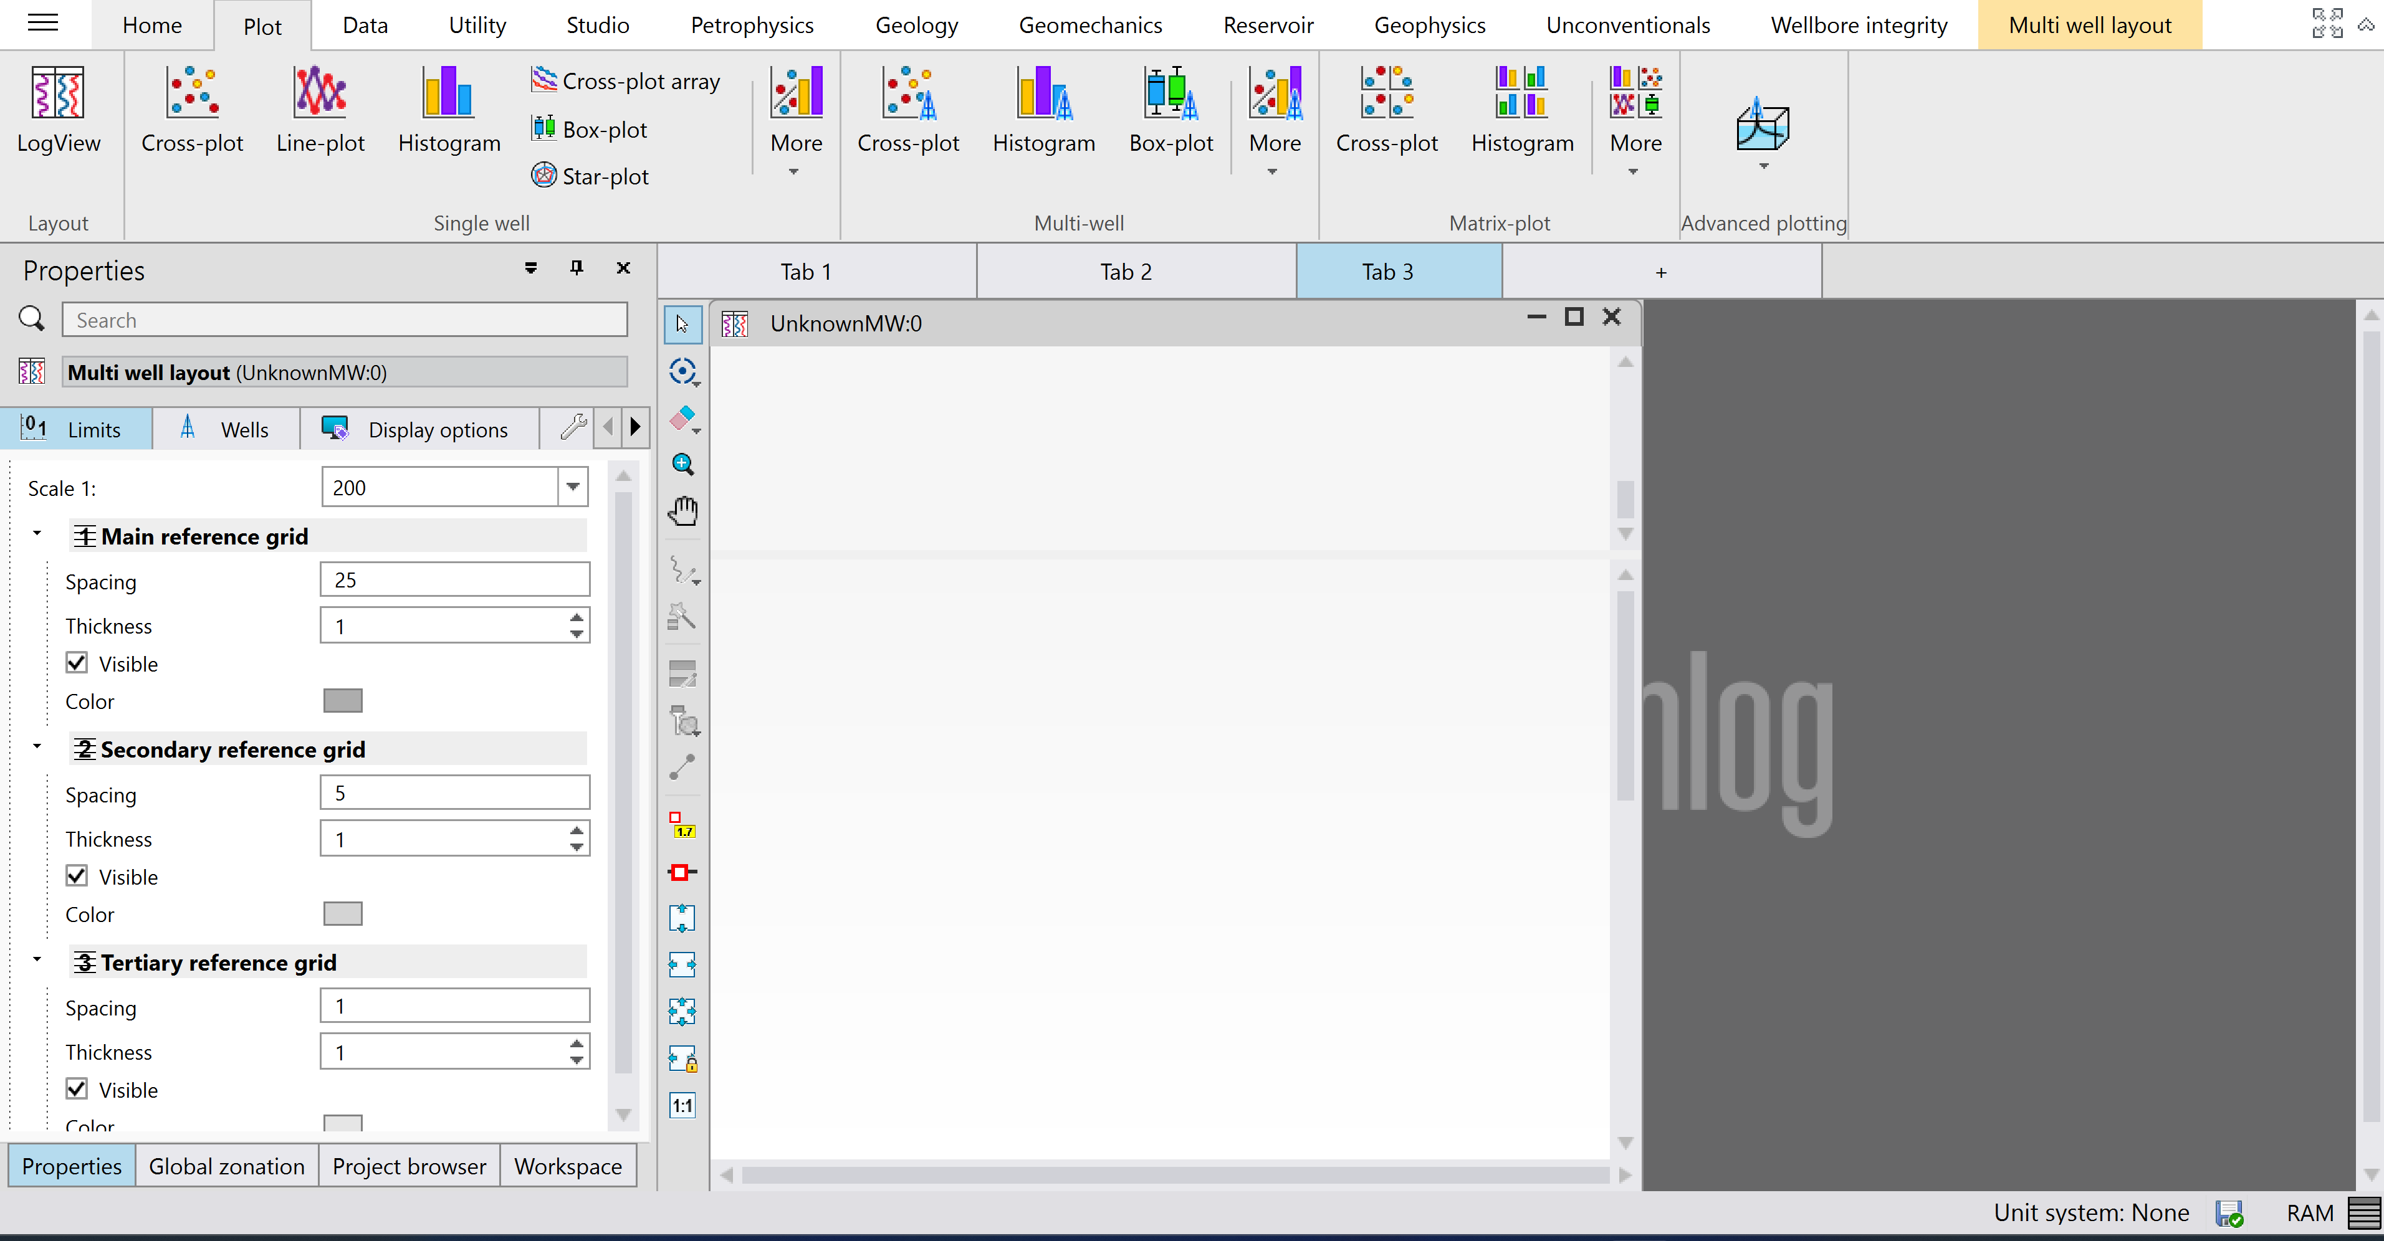
PLOT LOGS
CLICK ON PLOT AND SELECT LOGVIEW
A WELL LAYOUT WINDOW OPENS
LOG TRACK
LOG
DRAG AND DROP THE LOGS IN THE WELL LAYOUT WINDOW

Slide 6
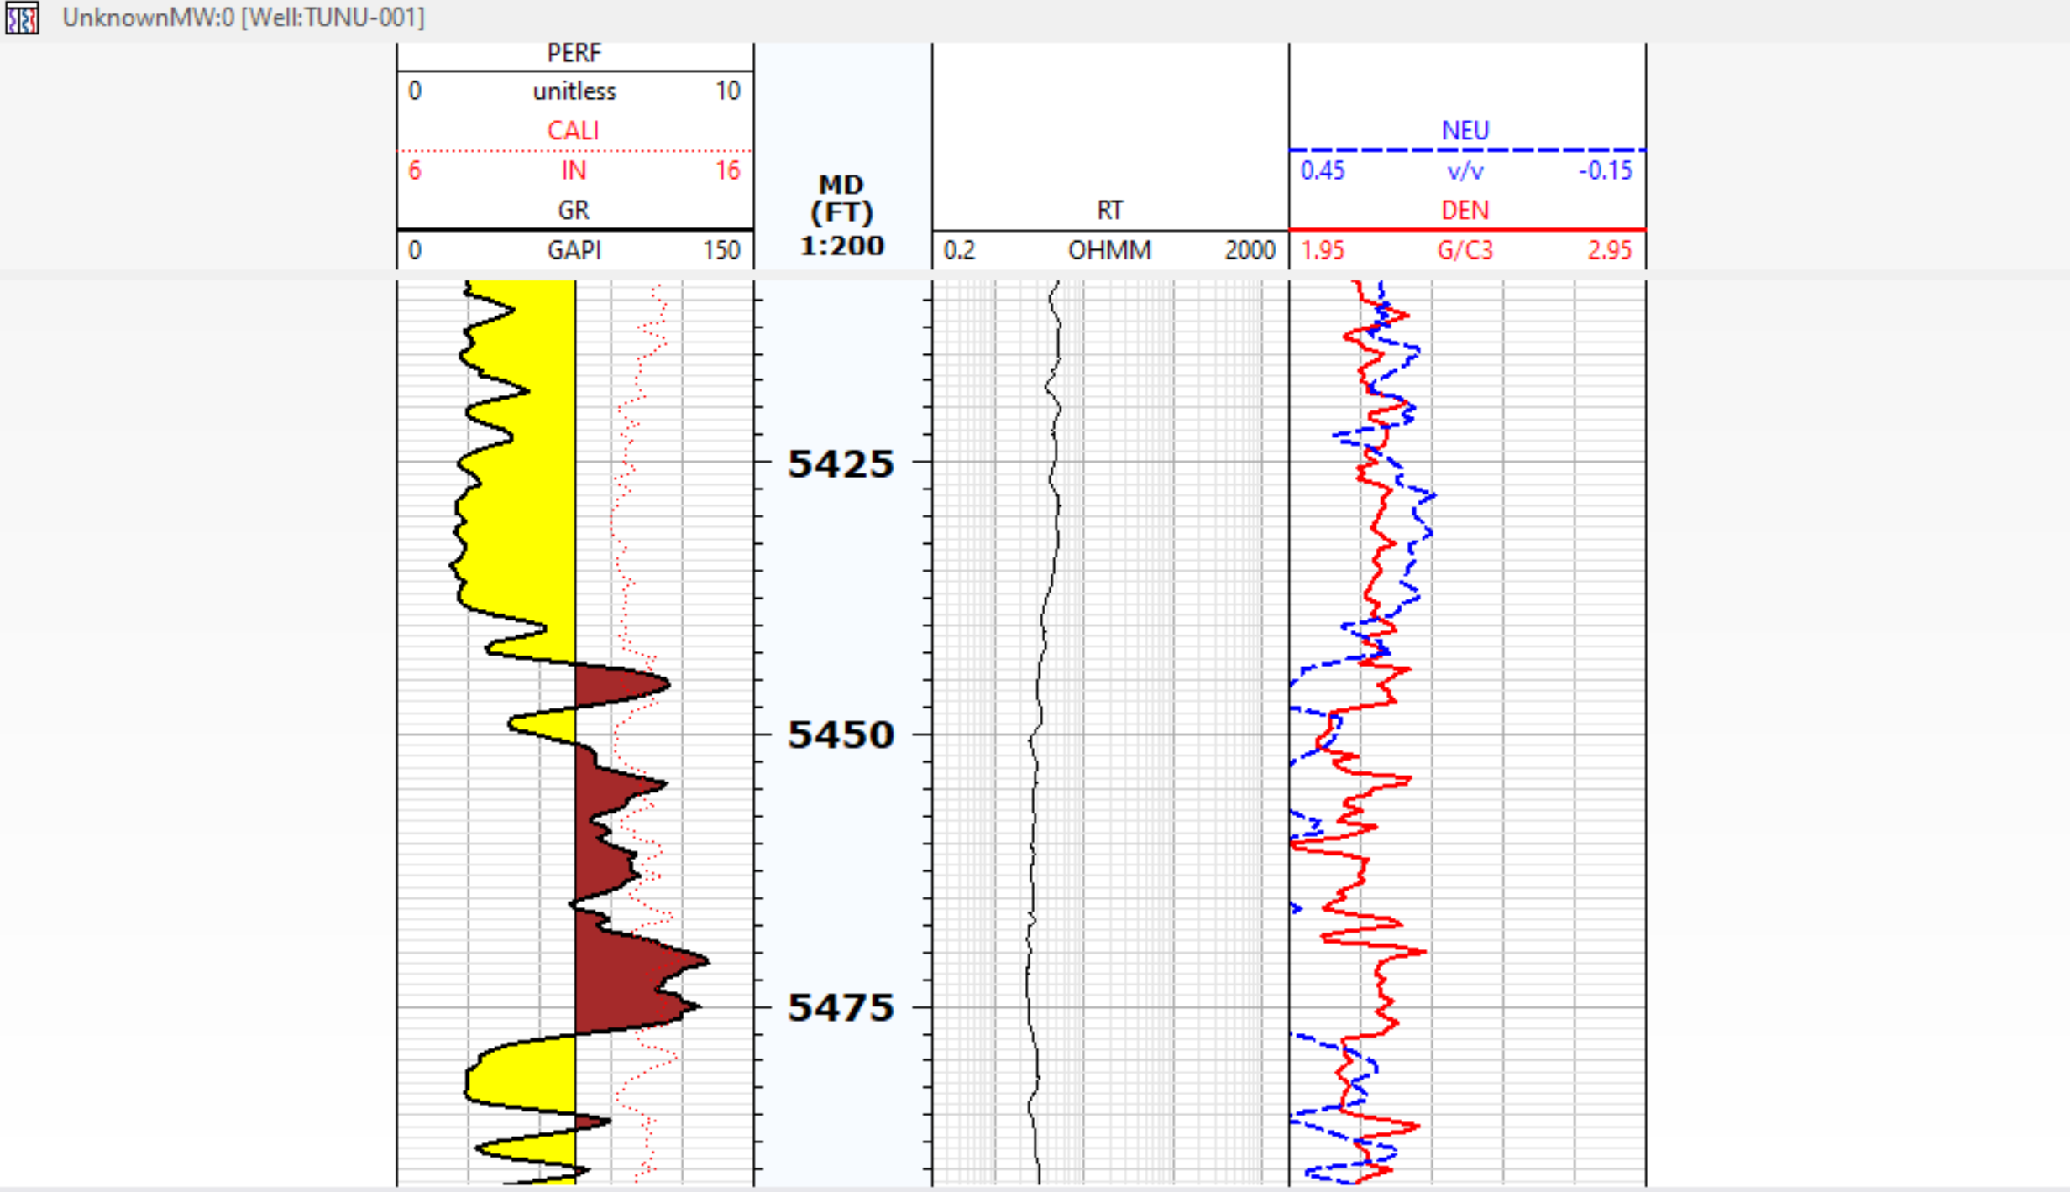
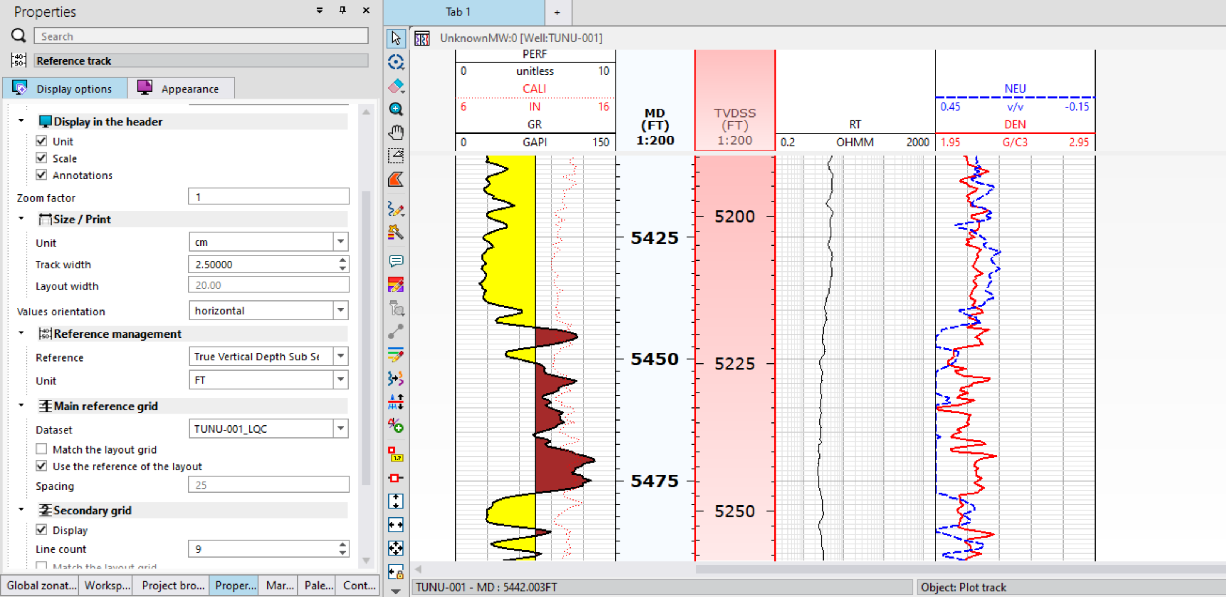
PLOT LOGS (2)
CLICK ON LOGS AND USE THE DIRECTIONS BOTTON TO MOVE LOGS UNTO THEIR DESIRED TRACKS.
SELECT ON THE MD LOG AND COPY AND PASTE. THIS CREATES A NEW MD TRACK RIGHT NEXT TO IT.
CLICK ON THE NEW MD TRACK GO TO THE PROPERTIES WINDOW TO CHANGE THE REFERENCE DEPTH TO TRUE VERTICAL DEPTH SUBSEA
CLICK ON LOG TRACKS AND USE THE DIRECTIONS BOTTON TO MOVE LOGS UNTO THEIR DESIRED LOCATION TO GET A LOG VIEW LIKE SO.

Slide 7
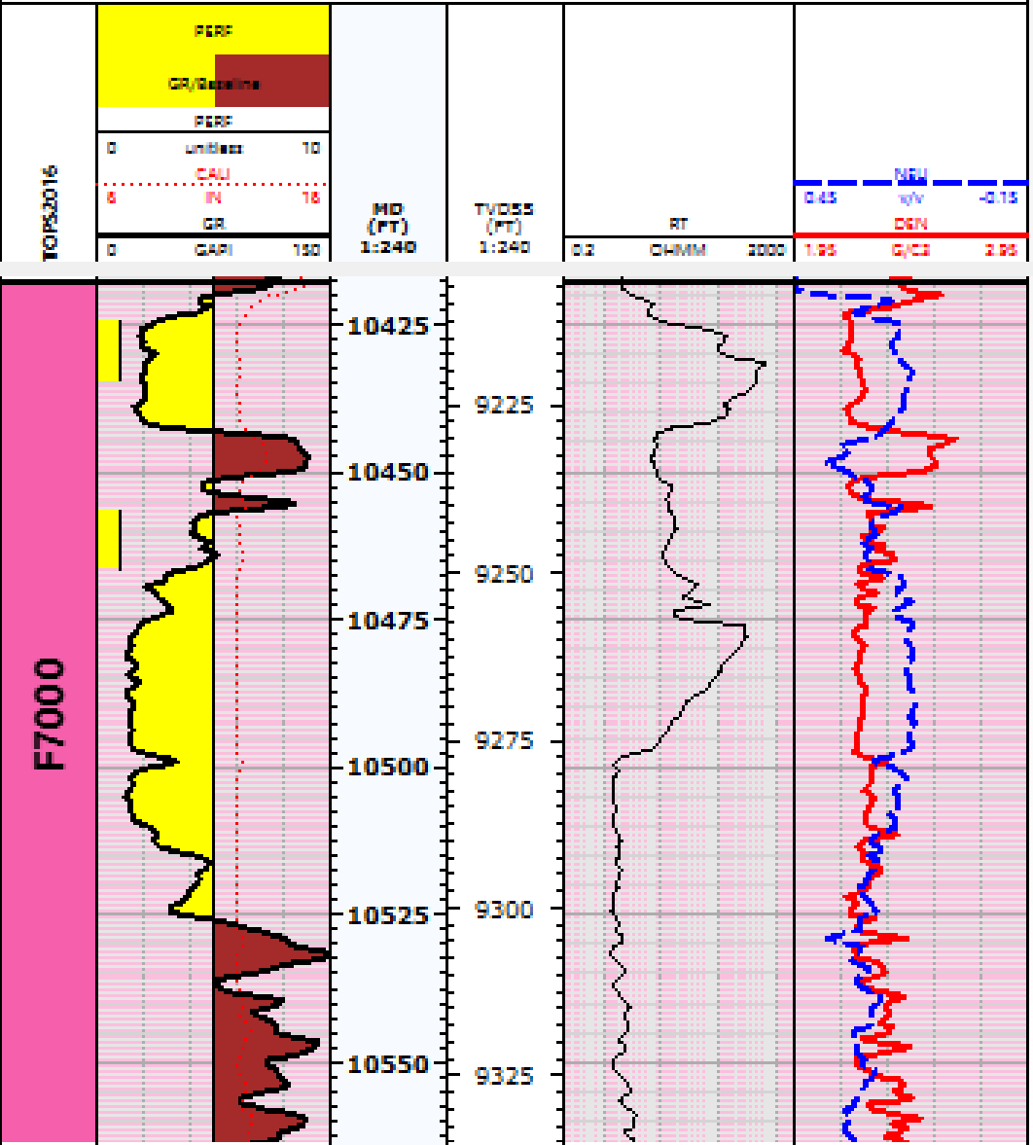
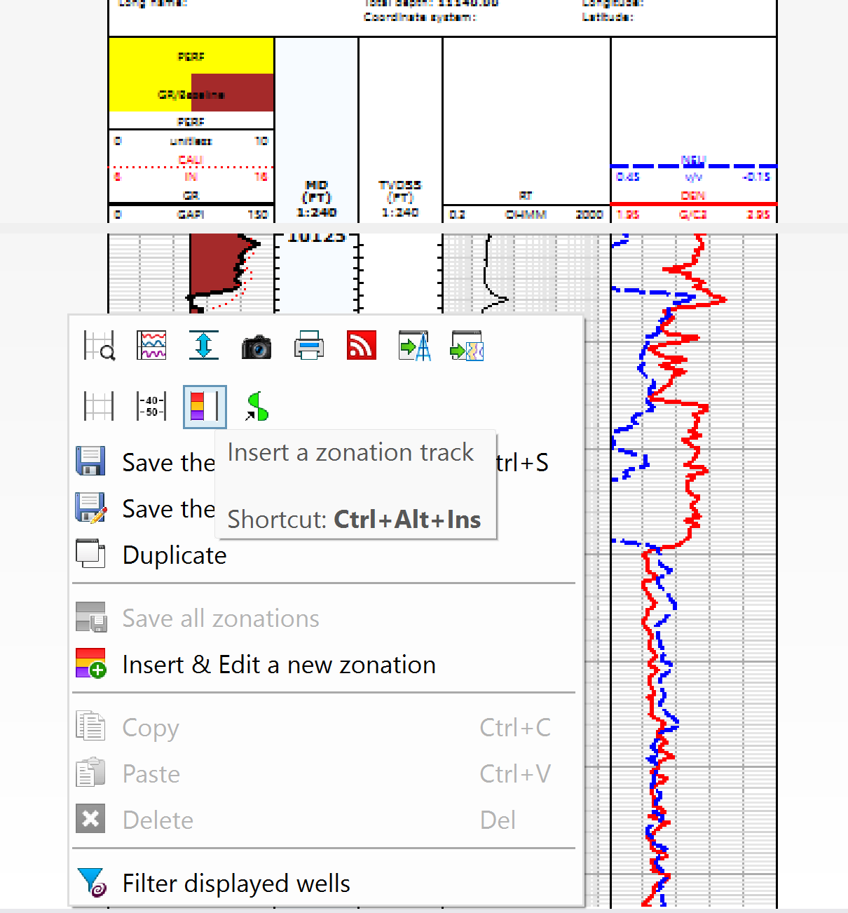
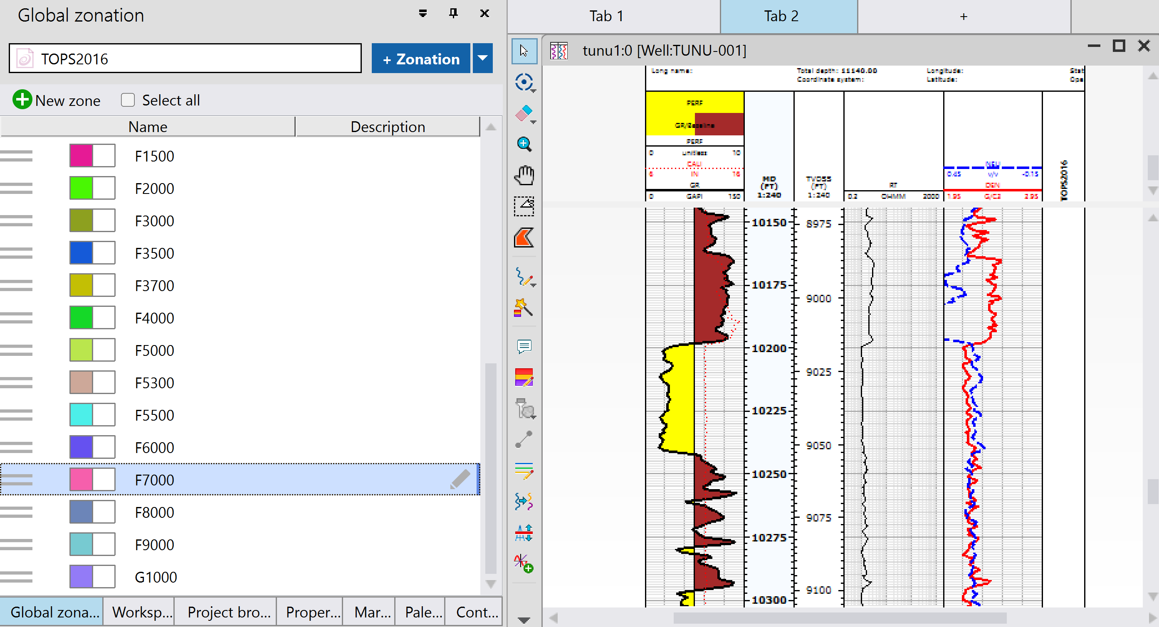
PLOT LOGS (3)
RIGHT CLICK AND SELECT THIS ICON TO CREATE A ZONATION TRACK
CLICK ON THE GLOBAL ZONATION WINDOW AND SELECT THE RESERVOIR OF INTEREST
WELL LOG LAYOUT DISPLAYS LIKE SO

Slide 8
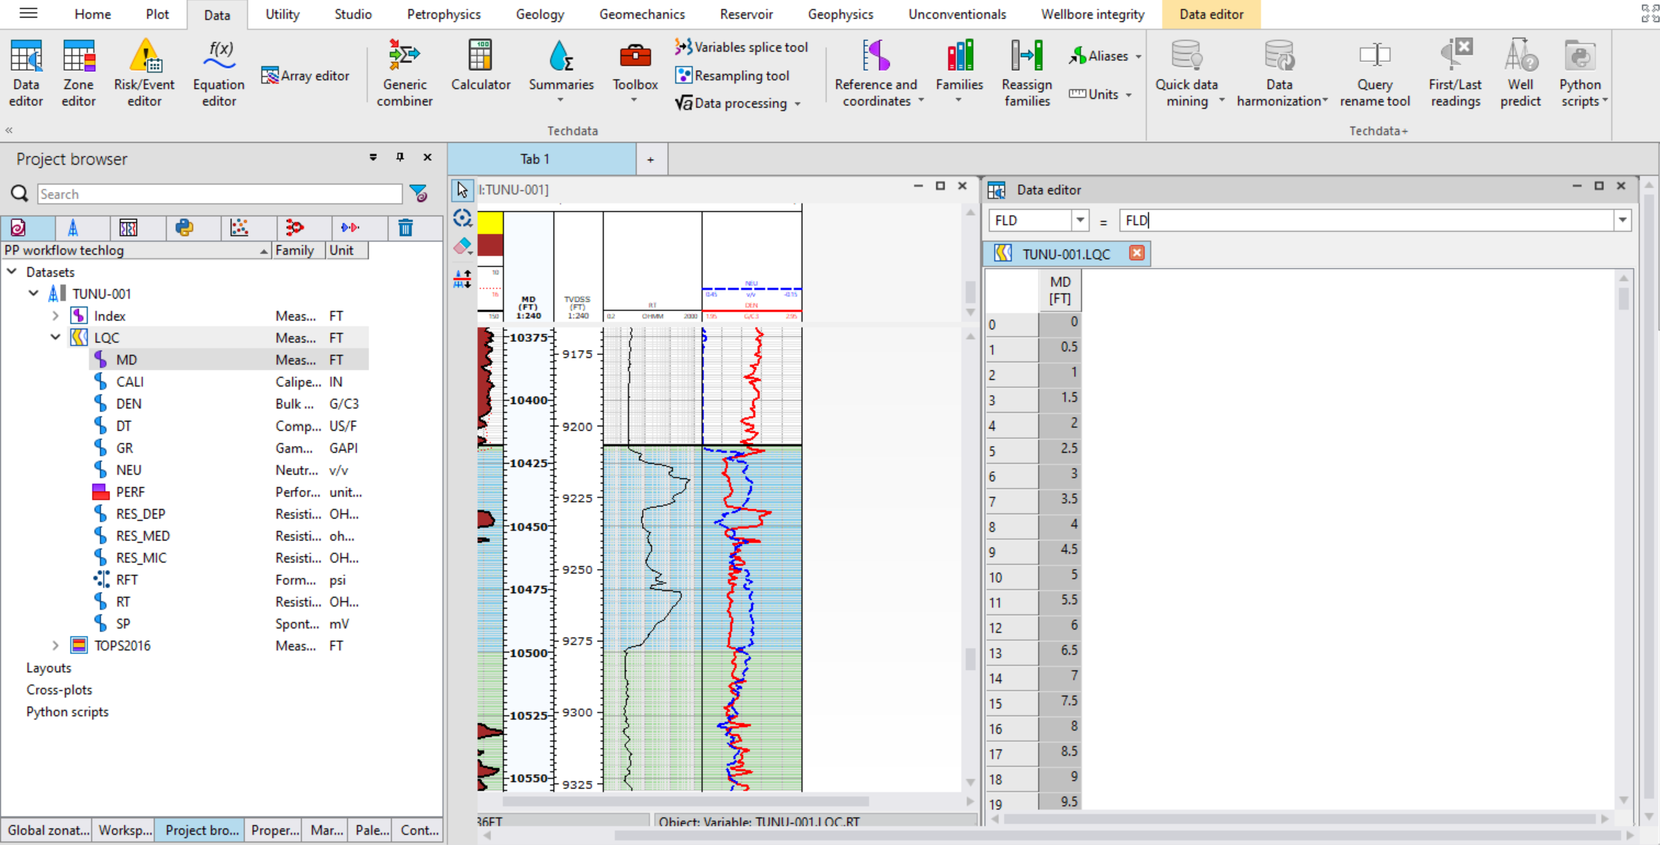
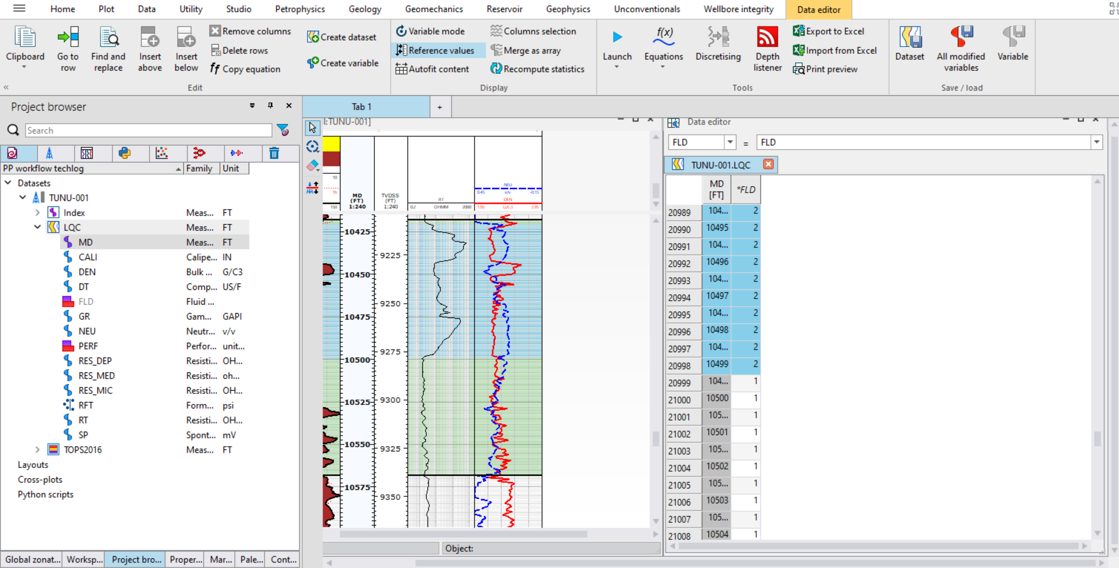
PLOT LOGS (4)
THE HIGHLIGHTED SECTION SHOWS UP ON THE DATA EDITOR WINDOW. INPUT THE FLUID CODES BASED ON WATER, OIL OR GAS. (1 FOR WATER, 2 FOR OIL AND 3 FOR GAS)
AFTER IDENTIFYING HYDROCARBON ZONES AND WATER ZONES, CLICK ON THIS SELECTION ICON TO HIGHLIGHT THE ZONES ON THE LOGS
CLICK ON DATA AND SELECT DATA EDITOR. A DATA EDITOR WINDOW SHOWS UP.
DRAG AND DROP ANY OF THE LQC DATASET IN THE DATA EDITOR WINDOW
ON THE FORMULA BAR, INPUT “FLD=FLD” AND PRESS ENTER TO CREATE A NEW LOG COLUMN FOR FLUID DISTRIBUTION
CLICK ON DATA EDITOR AND CLICK ON SAVE ALL MODIFIED VARIABLES TO SAVE THE FLD LOG

Slide 9
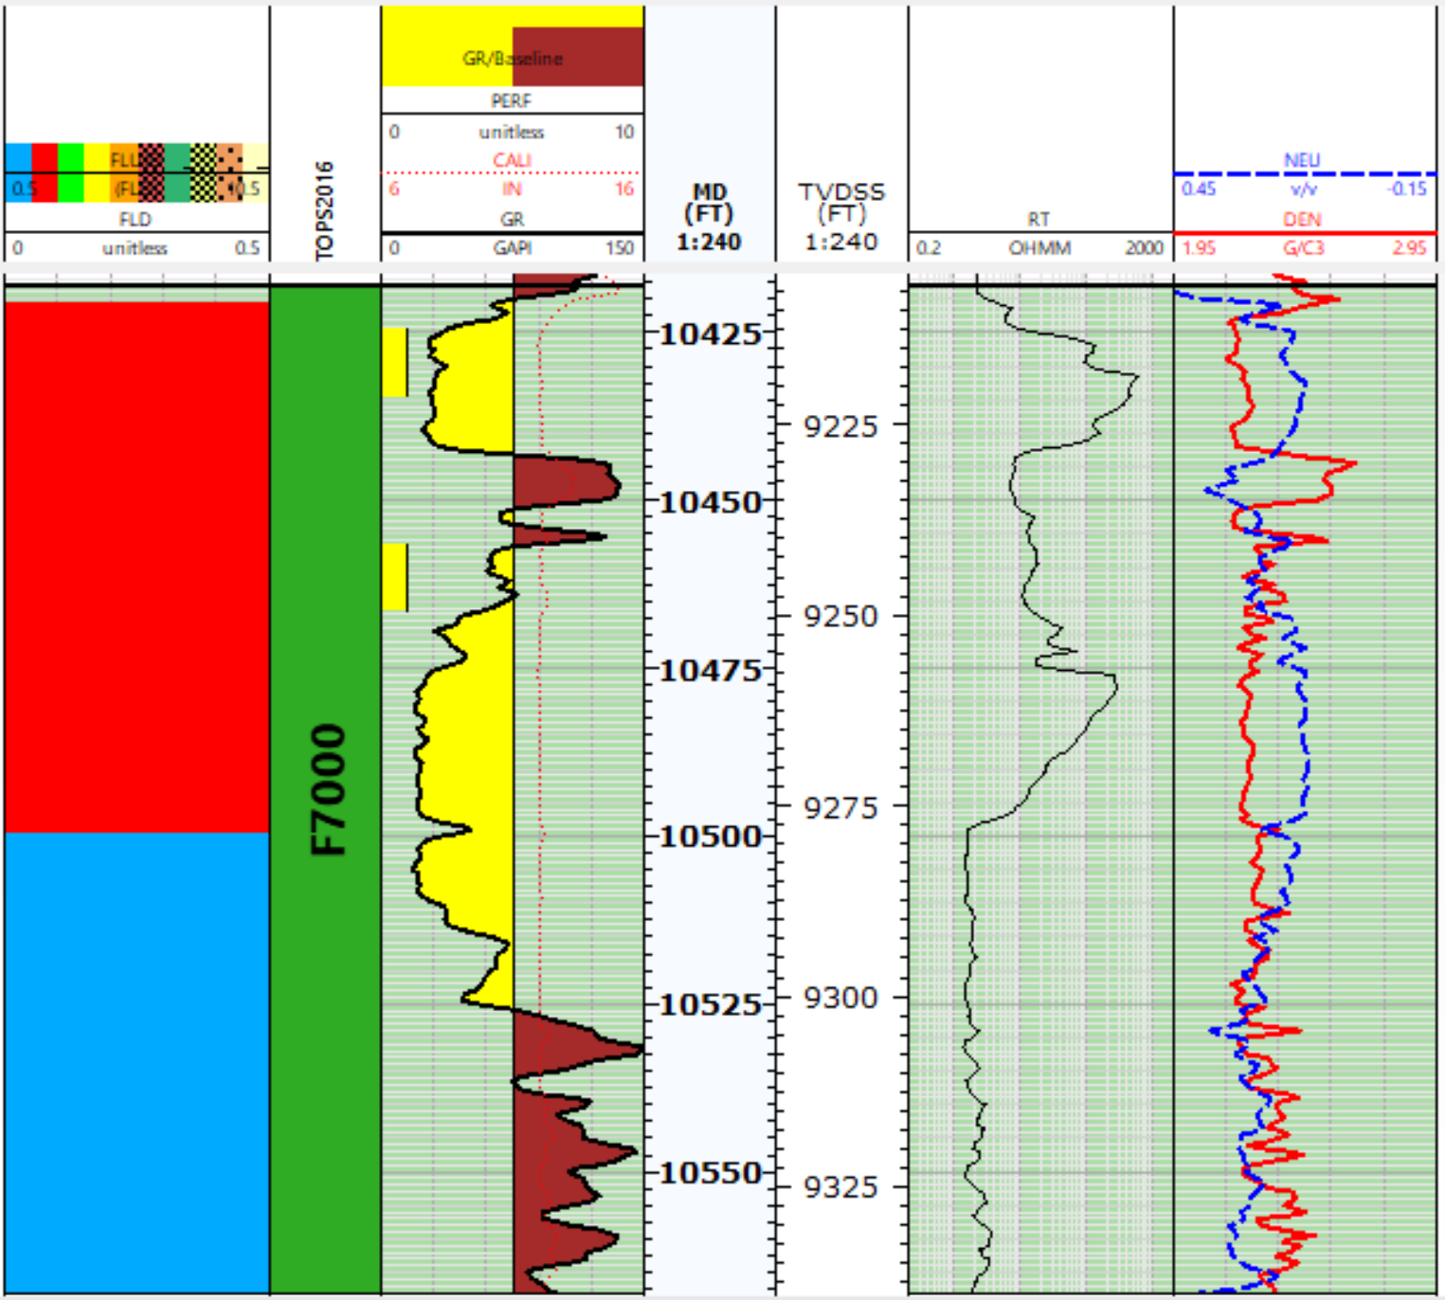
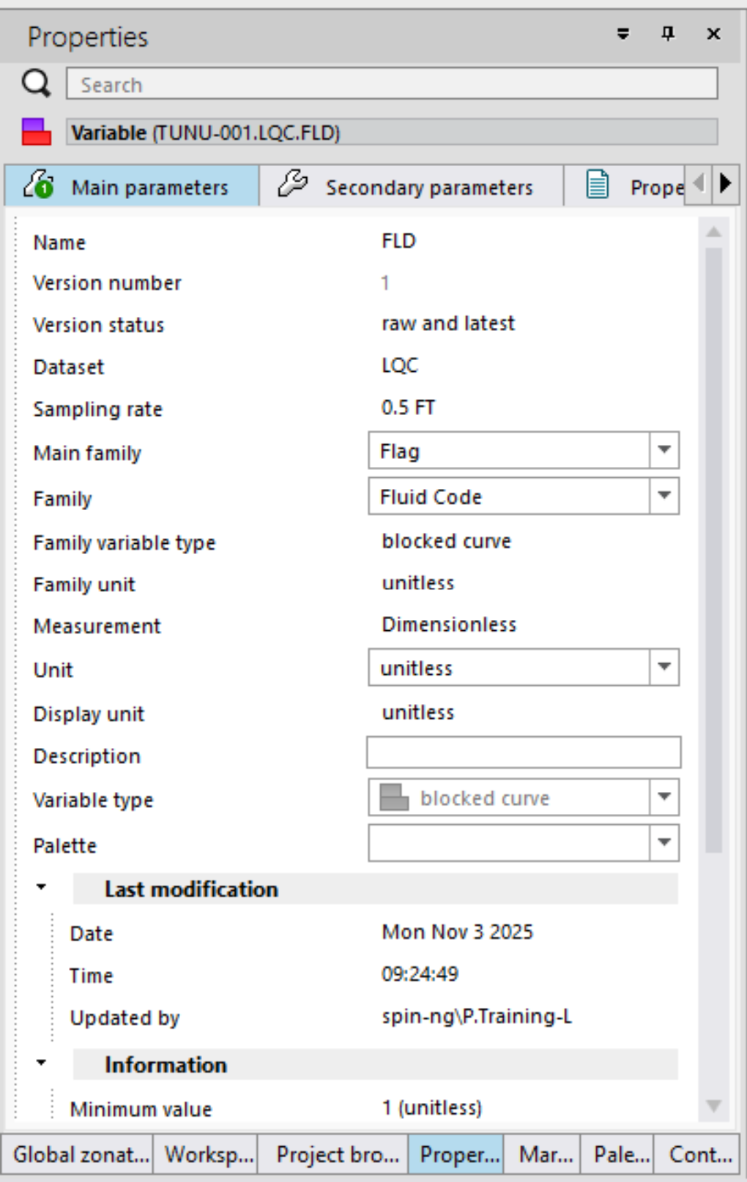
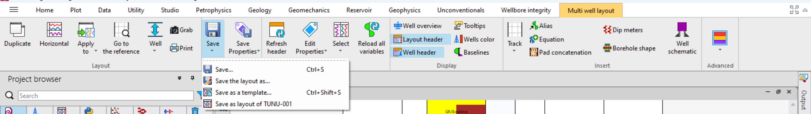
PLOT LOGS (5)
FLD LOG SHOWS UP ON THE PROJECT BROWSER BUT PARAMETERS ARE NOT CORRECT ( HENCE, ITS APPEARANCE DIFFERENT FROM THE OTHER LOGS). SELECT THE FLD LOG AND CLICK ON PROPERTIES. ON THE PROPERTIES WINDOW, SELECT THE APPROPIATE UNIT FOR THE LOG (IN THIS CASE, “unitless”)
DRAG AND DROP THE FLD LOG ON THE WELL LOG LAYOUT AND YOU SHOULD HAVE A LAYOUT LIKE THIS.
CLICK ON MULTI WELL LAYOUT AND CLICK ON SAVE TO SAVE THE WELL LOG LAYOUT THAT HAS BEEN CREATED

Slide 10
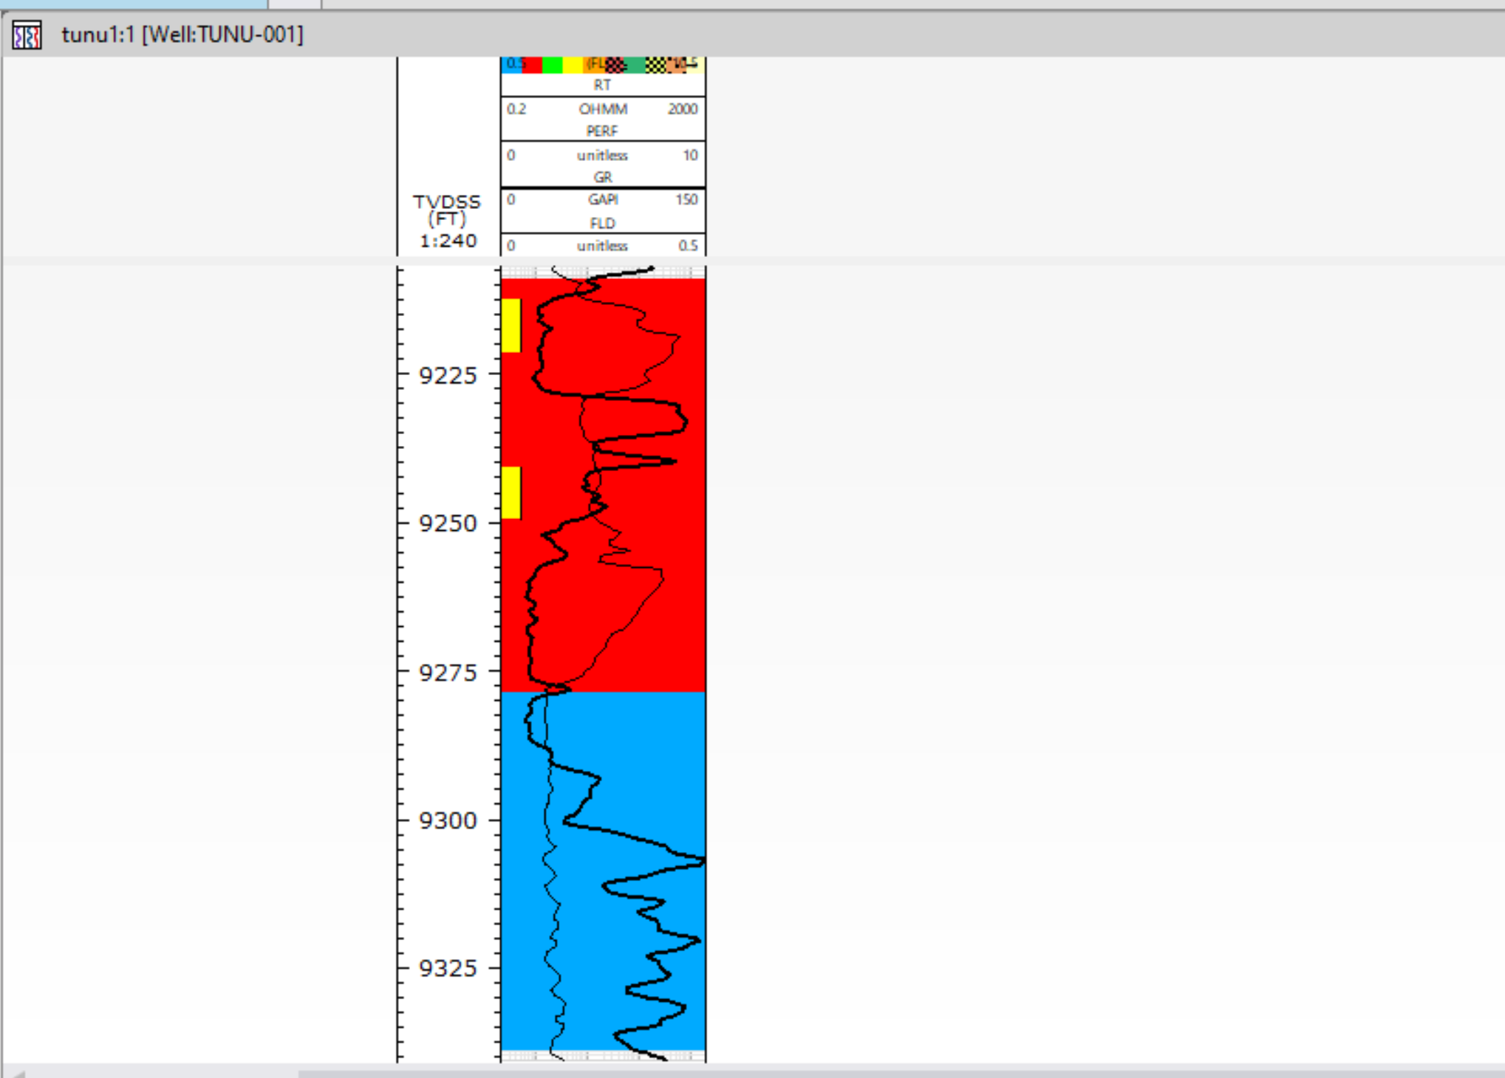
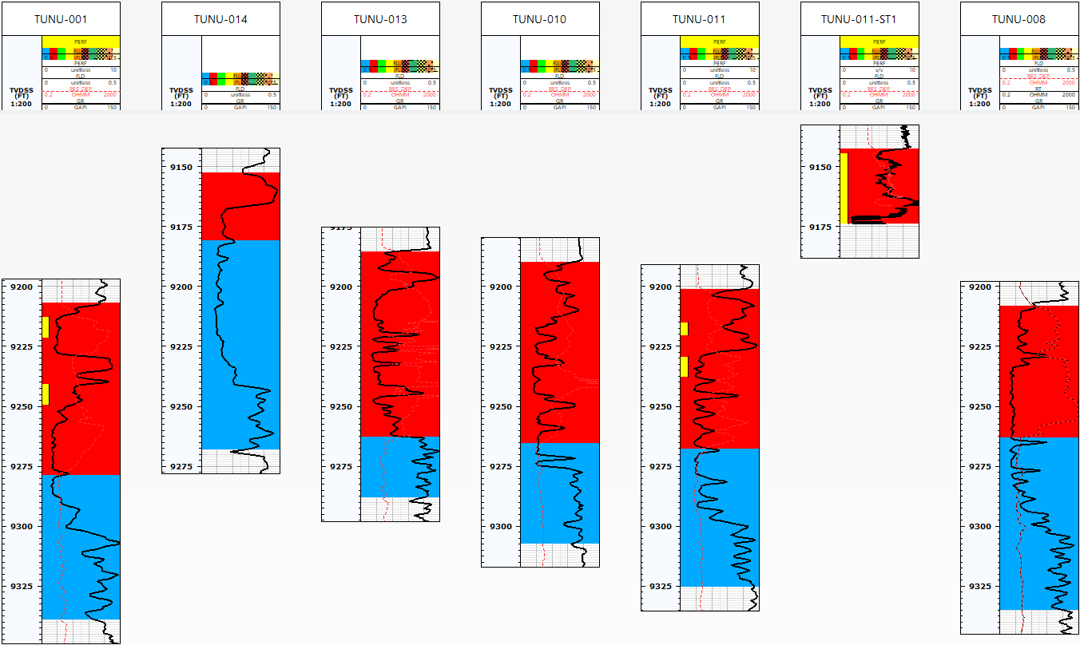
HCDP
ANOTHER WELL LAYOUT CAN BE CREATED PUTTING THE RESISTIVITY LOG, GR LOG, PERF LOG AND FLD LOG ON THE SAME TRACK NEXT TO A TVDSS LOG TO HAVE A SIMPLE VIEW OF FLUID DISTRIBUTION IN THE WELL
STEPS FROM SLIDE 4 THROUGH 8 CAN BE REPEATED FOR OTHER WELLS. AND THE FLUID DISTRIBUTION LOGS CAN ALL BE PLACED ON THE SAME WELL LOG LAYOUT TO HAVE A HYDROCARBON DISTRIBUTION PLOT
*NOTE: TO DELETE A LOG, TRACK OR BASELINE IN WELL LOG WINDOW, SIMPLY CLICK ON IT AND PRESS DELETE ON YOUR KEYBOARD

Slide 11
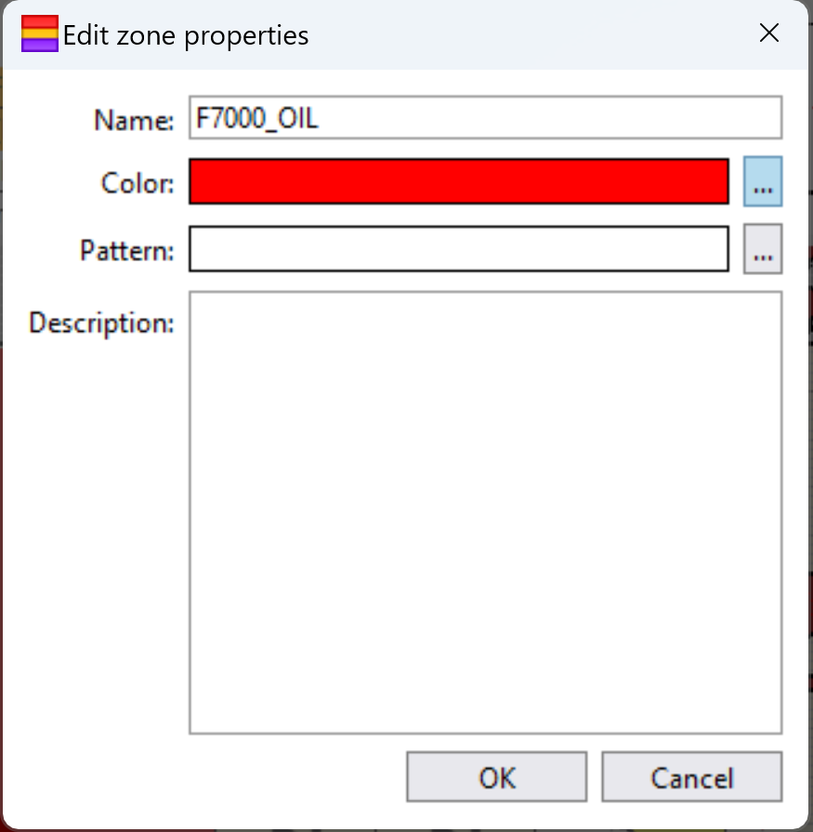
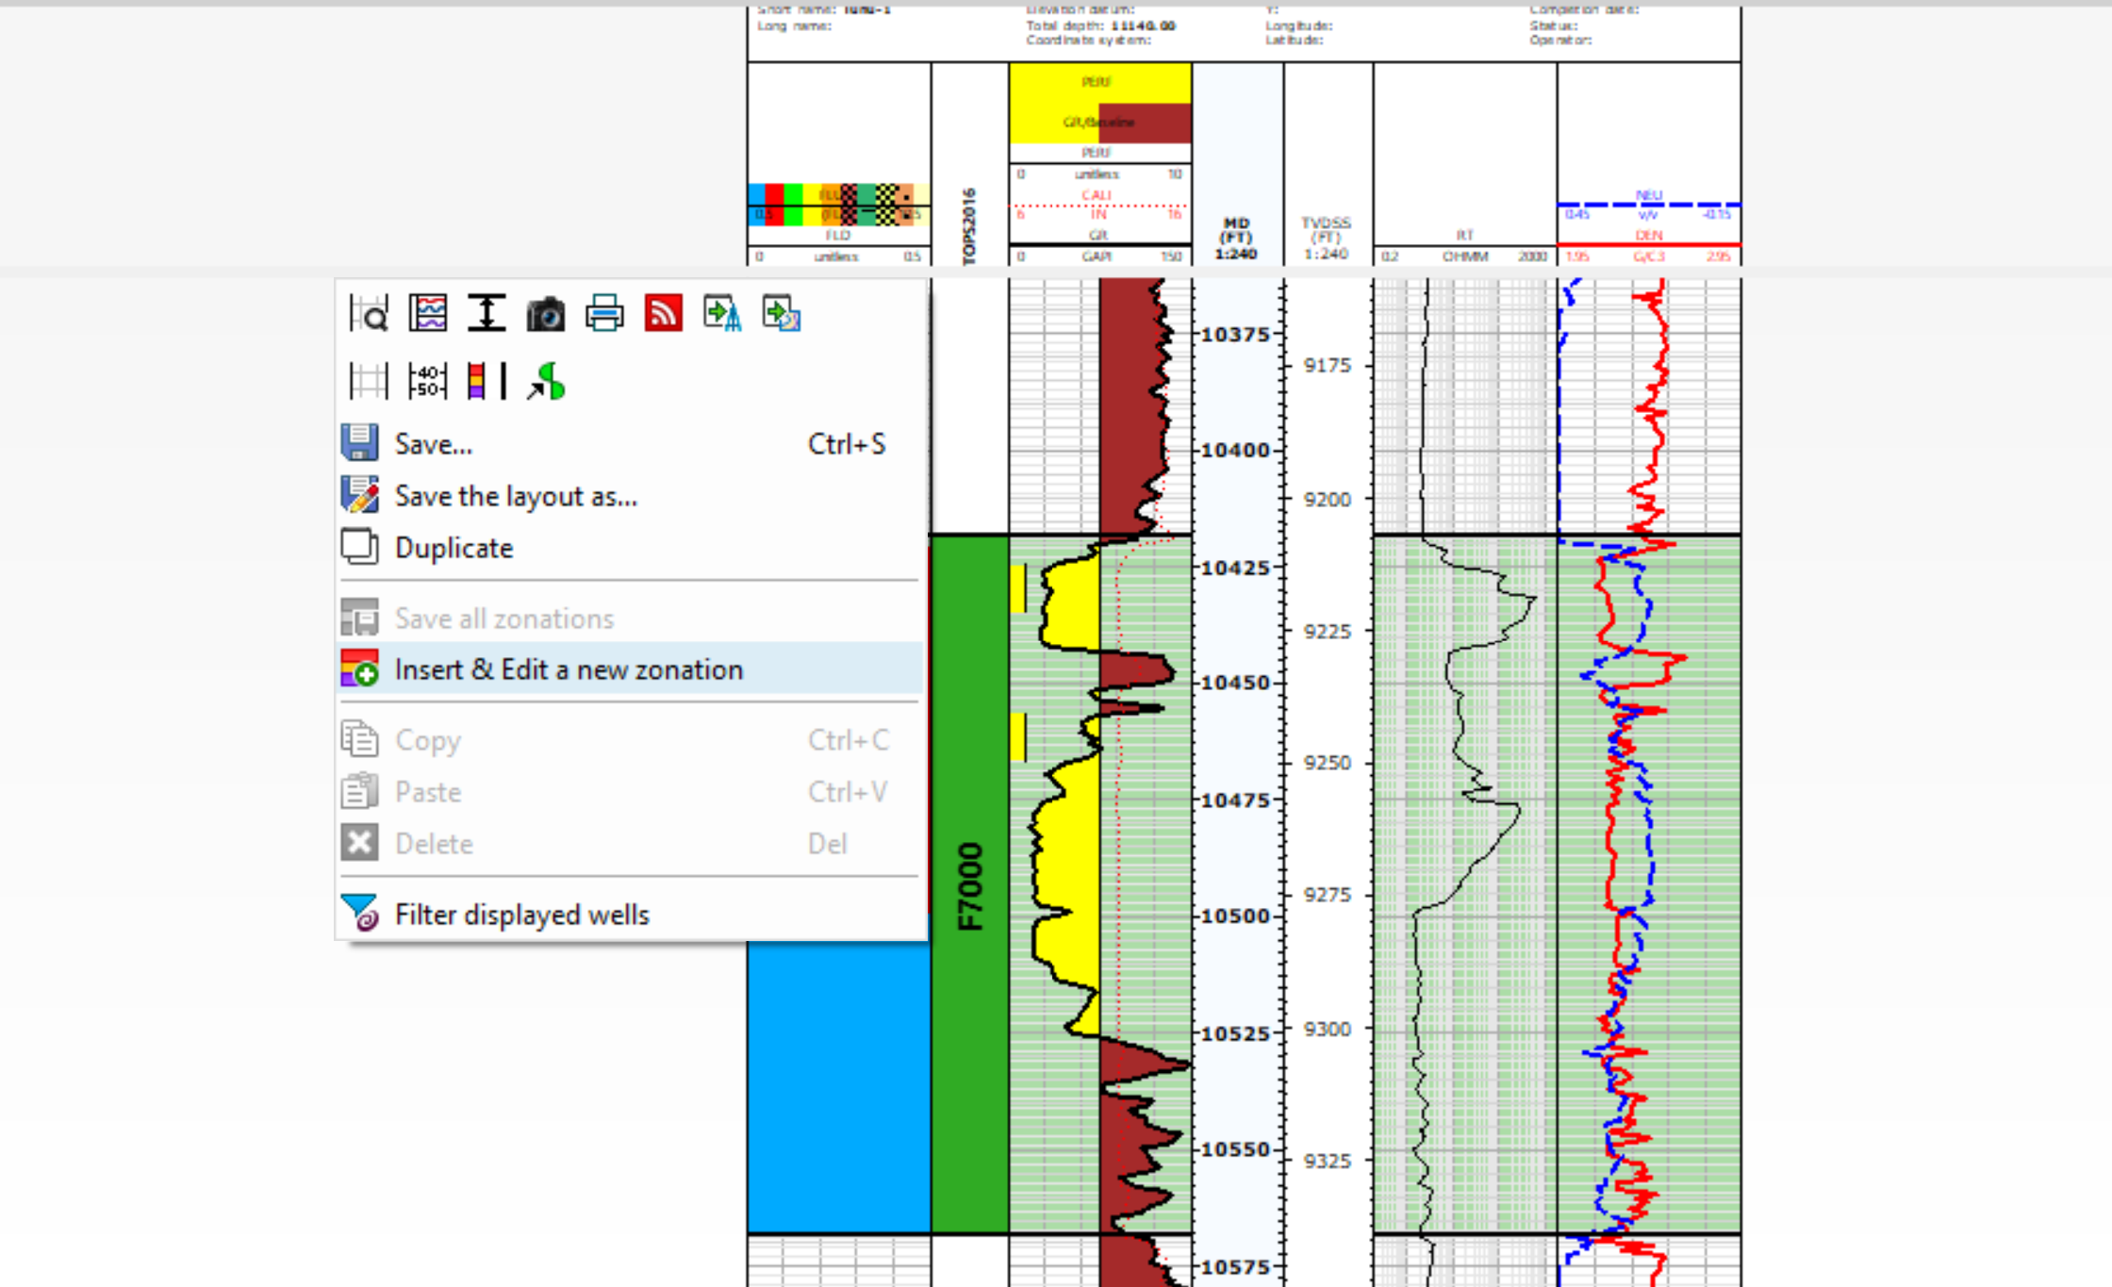
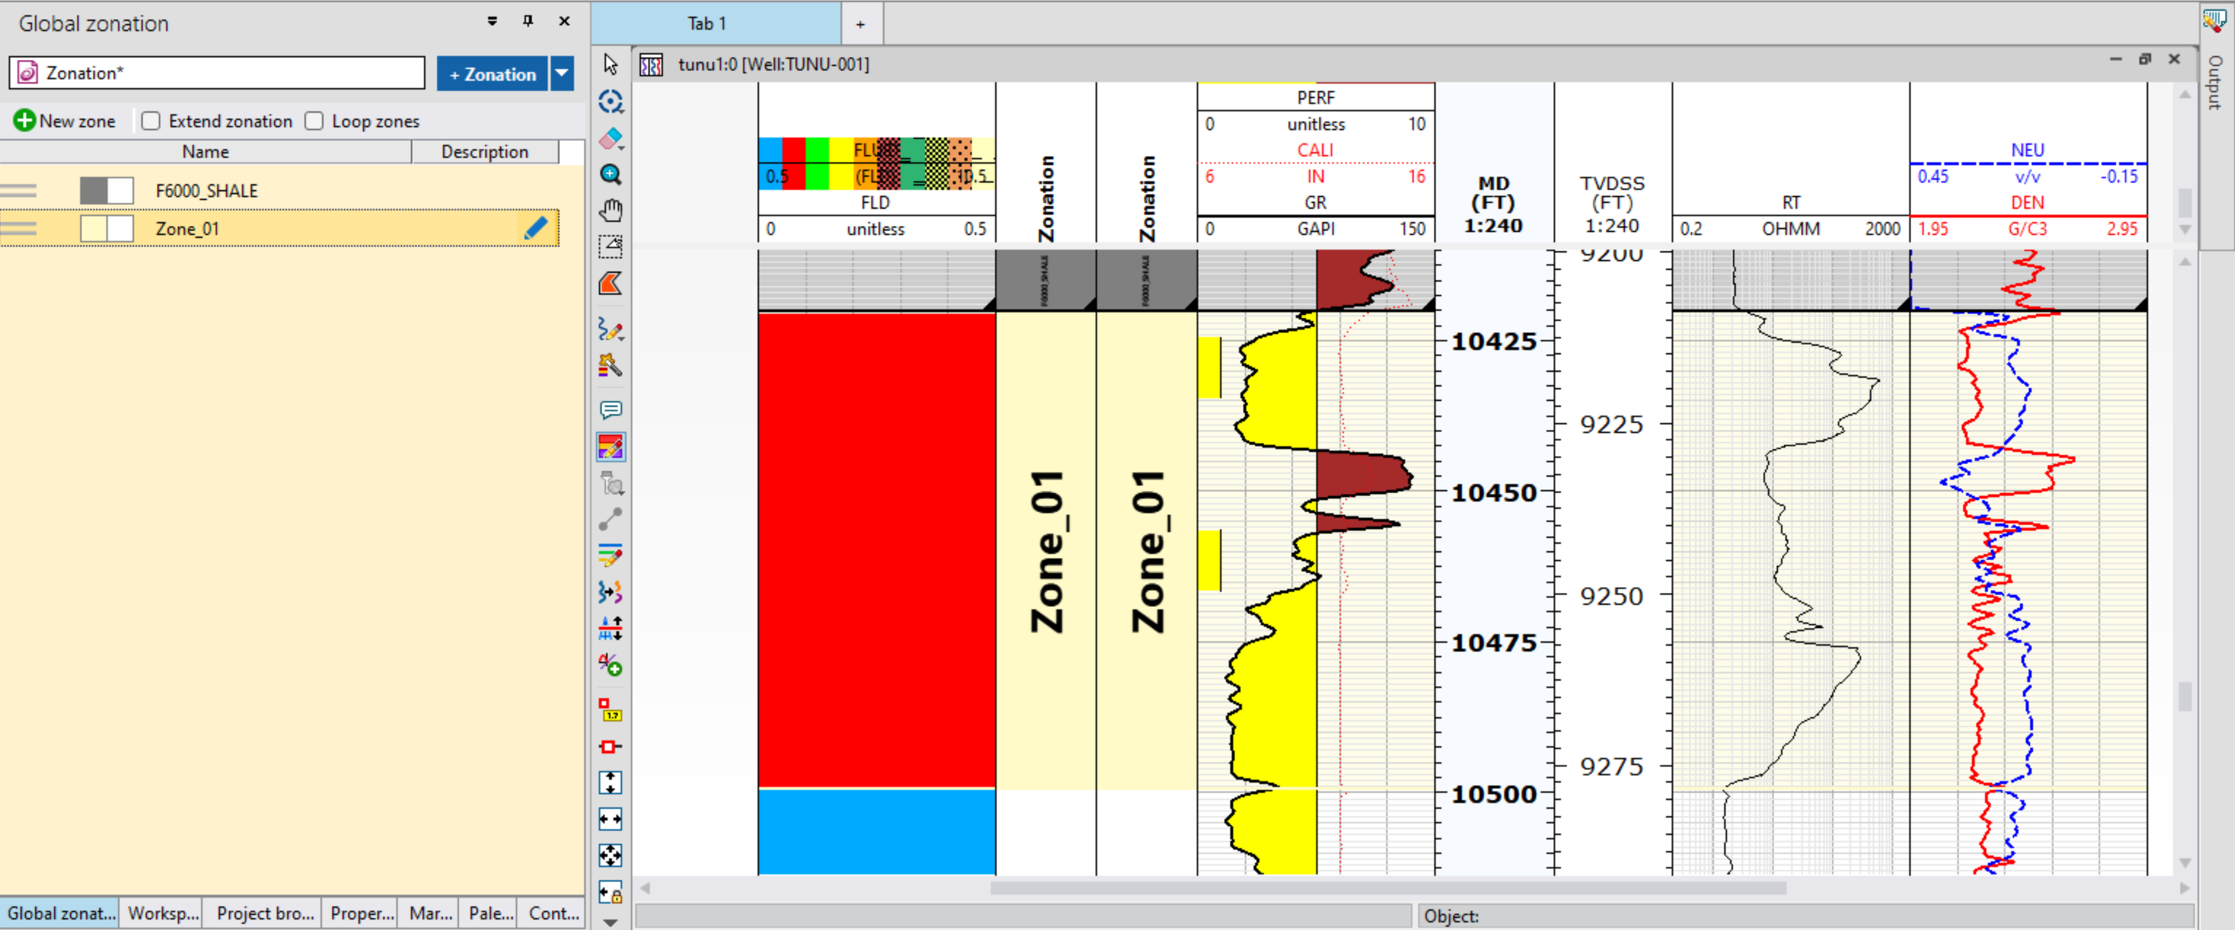
NEW ZONATION
USE THE CUSOR TO SELECT AND HIGHLIGHT NEW ZONES BASED ON FLUID FILL AND TOP AND BOTTOM SHALE. CLICK ON NEW ZONE AFTER HIGHLIGHTING EACH ZONE
CLICK ON THIS ICON TO EDIT THE ZONE NAME AND COLOUR
RIGHT CLICK ON THE WELL LOG LAYOUT AND CLICK ON THIS OPTION TO CREATE A NEW ZONATION

Slide 12
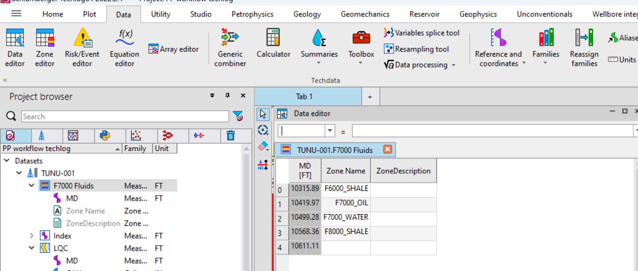
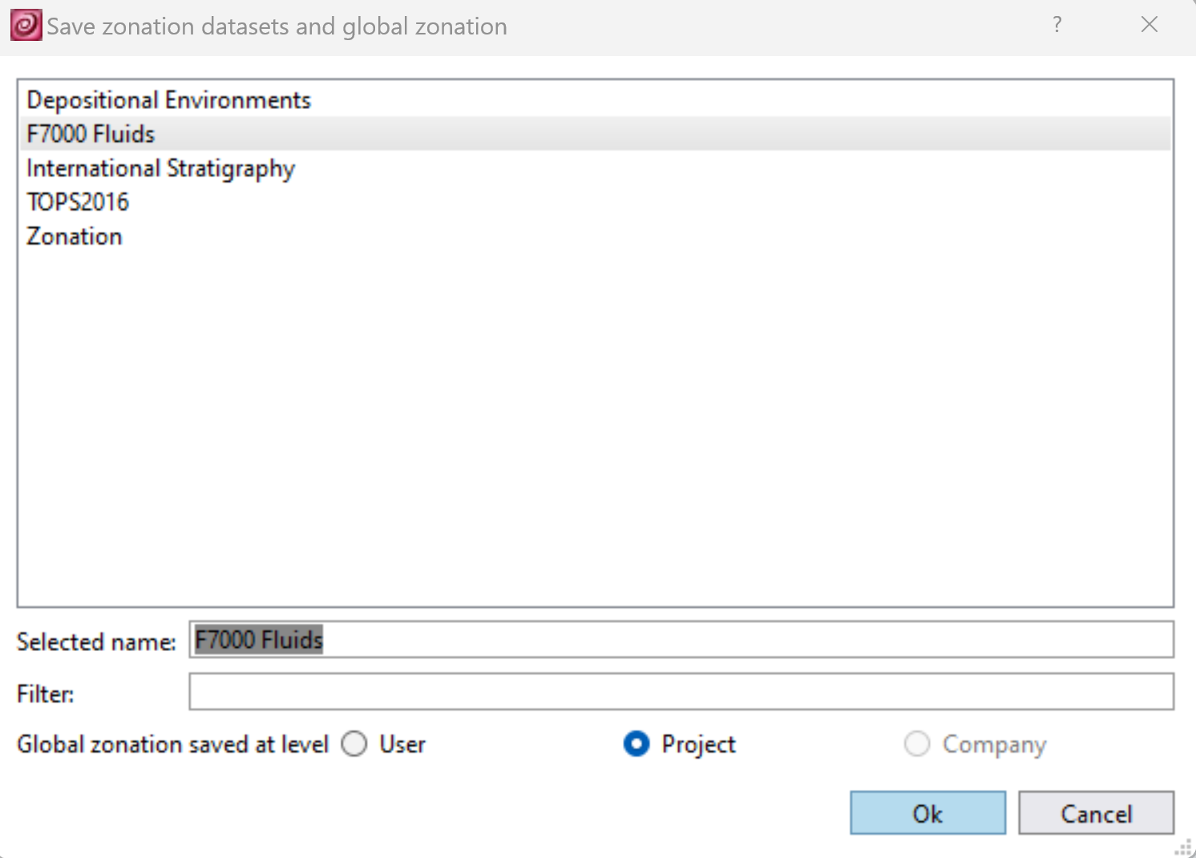
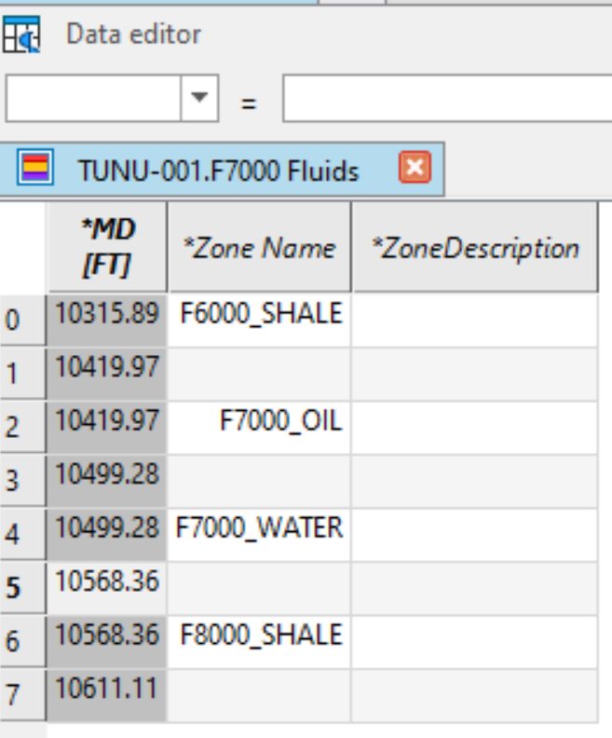
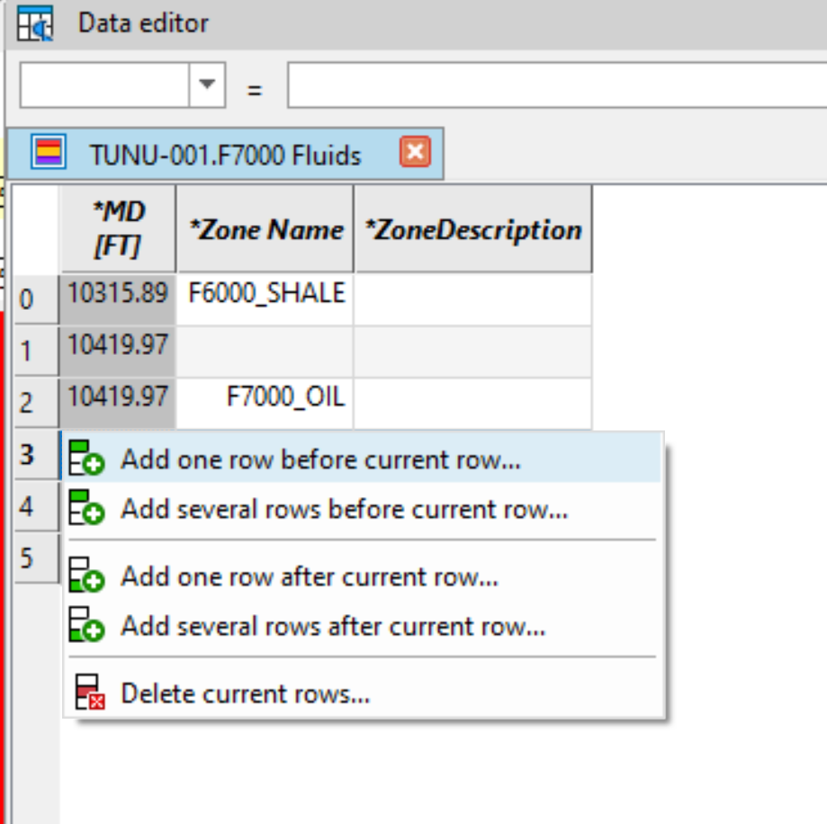
NEW ZONATION (2)
TO QC THE NEW ZONATION CREATED, DRAG AND DROP THE NEW ZONATION FROM THE PROJECT BROWSER TO DATA EDITOR
CLICK ON MULTI WELL LAYOUT AND CLICK ON SAVE THE ZONATION TO SAVE THE NEW ZONATION JUST CREATED
INPUT A NAME FOR THE ZONATION AND CLICK OKAY
SELECT AND RIGHT CLICK ON THE ZONATIONS AND A ROW BETWEEN ALL ZONES
ON THE MD COLUMN, INPUT THE DEPTH VALUE FOR NEXT ROW ON EACH ROWS IN BETWEEN ZONES CREATED. SAVE THE MODIFIED VARIABLES AFTER THIS STEP

Slide 13
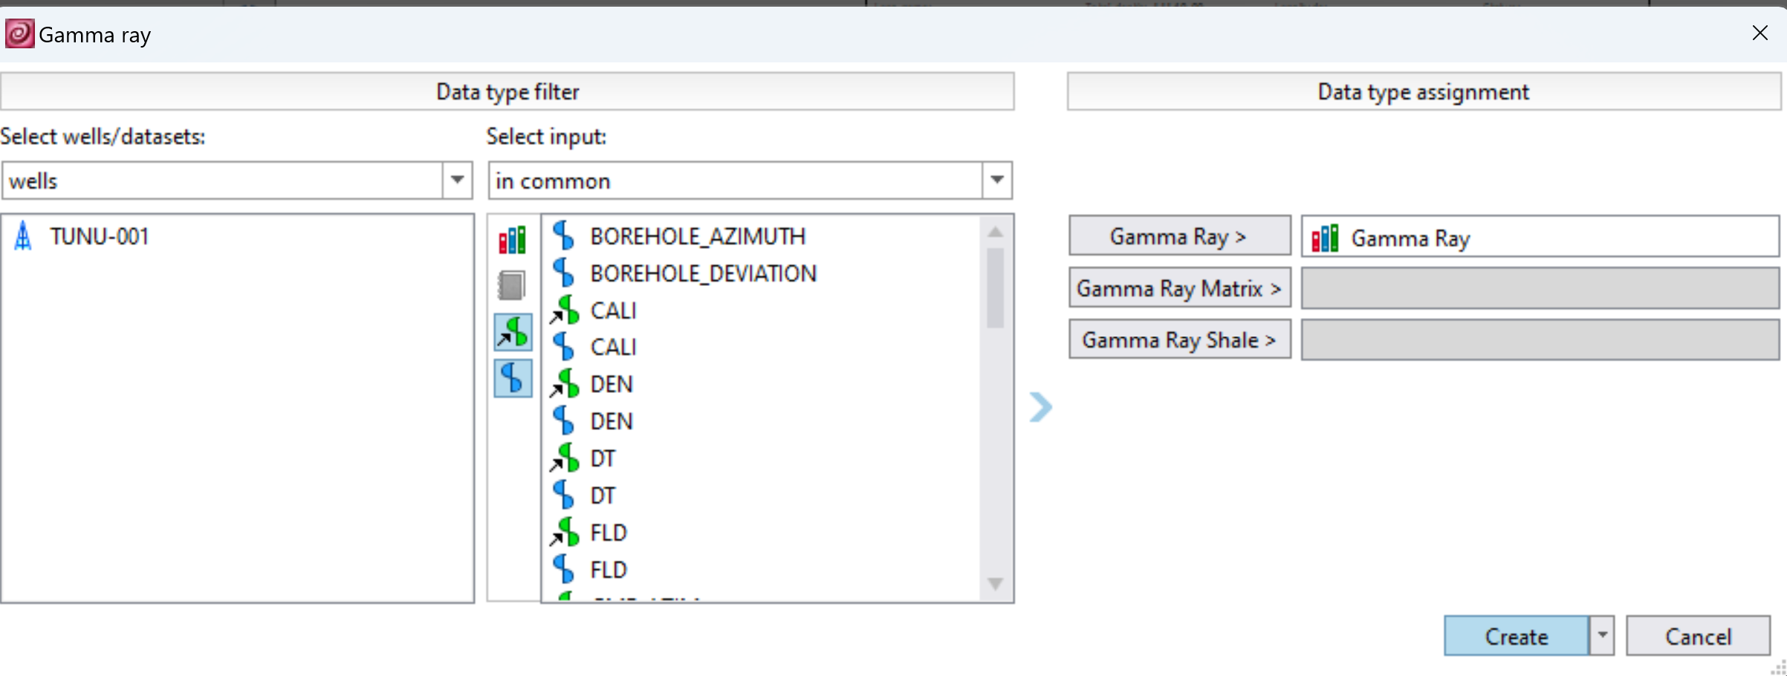
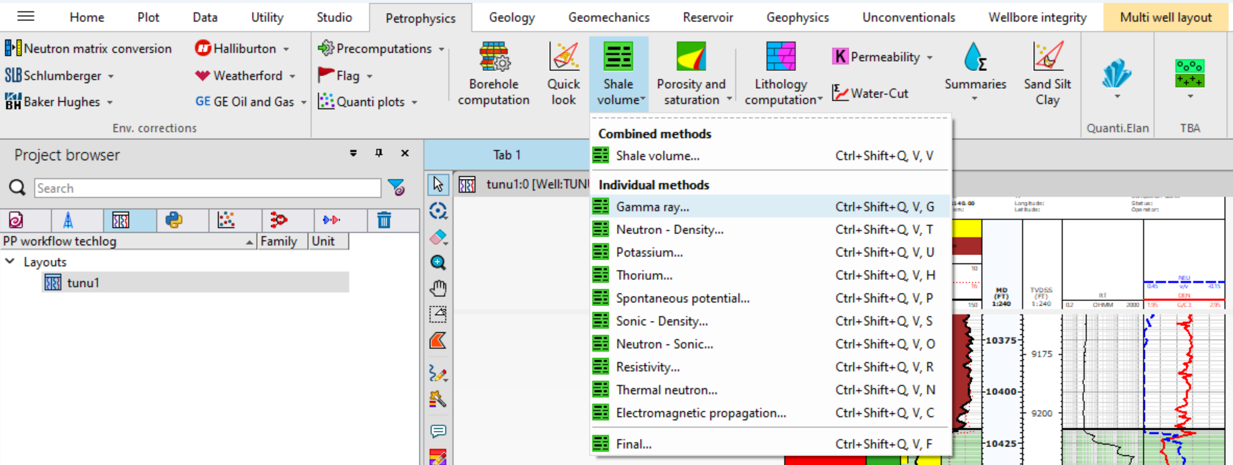
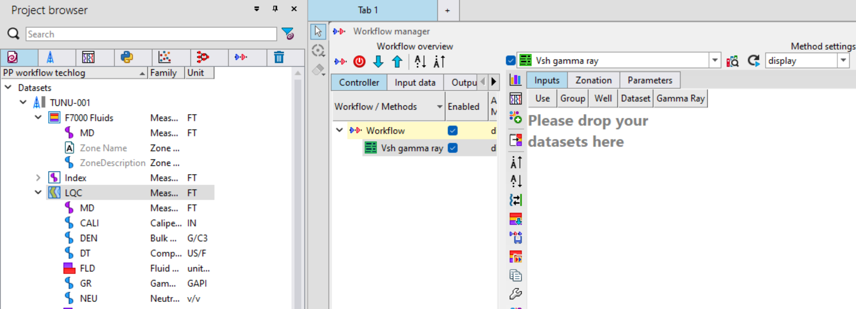
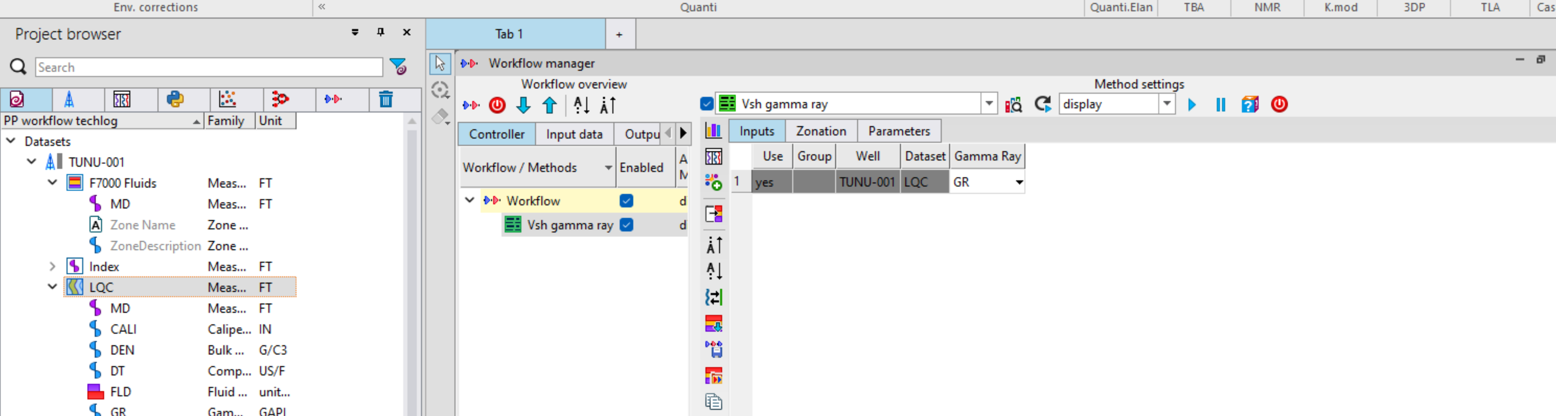
VSHALE ESTIMATION
CLICK ON PETROPHYSICS, SELECT SHALE VOLUME AND NAVIGATE TO GAMMA RAY
SELECT GAMMA RAY FROM THE INPUT WINDOW AND CLICK ON GAMMA RAY TO INPUT THE LOG AND CLICK ON CREATE
DRAG AND DROP LQC

Slide 14
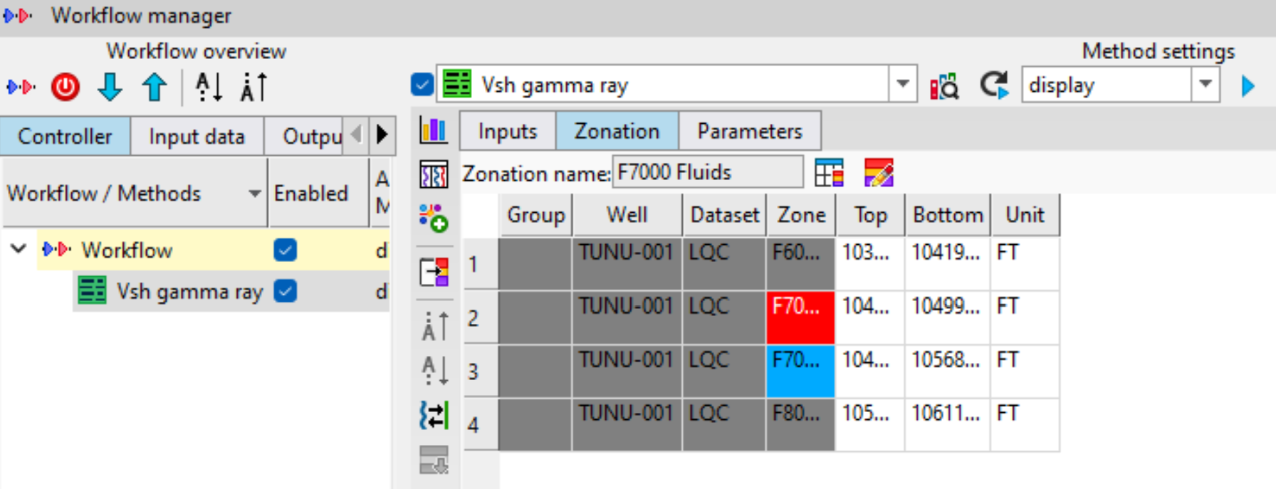
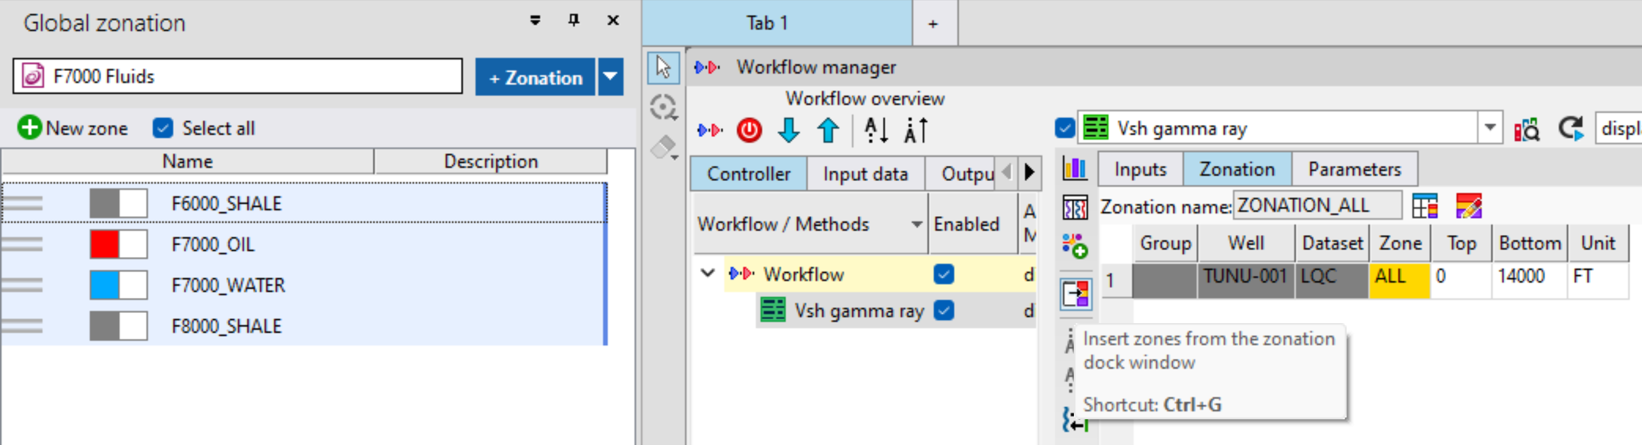
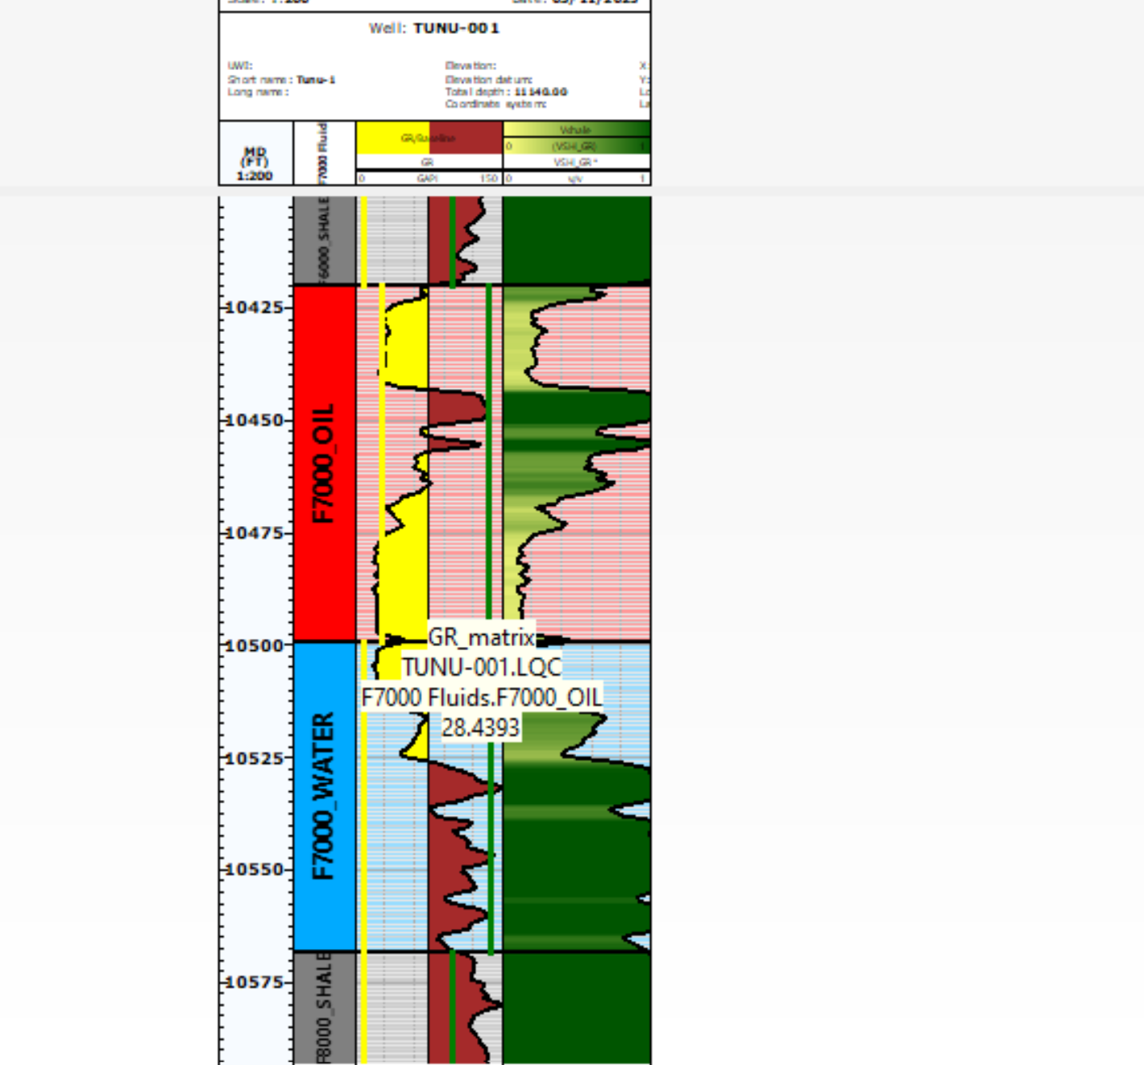
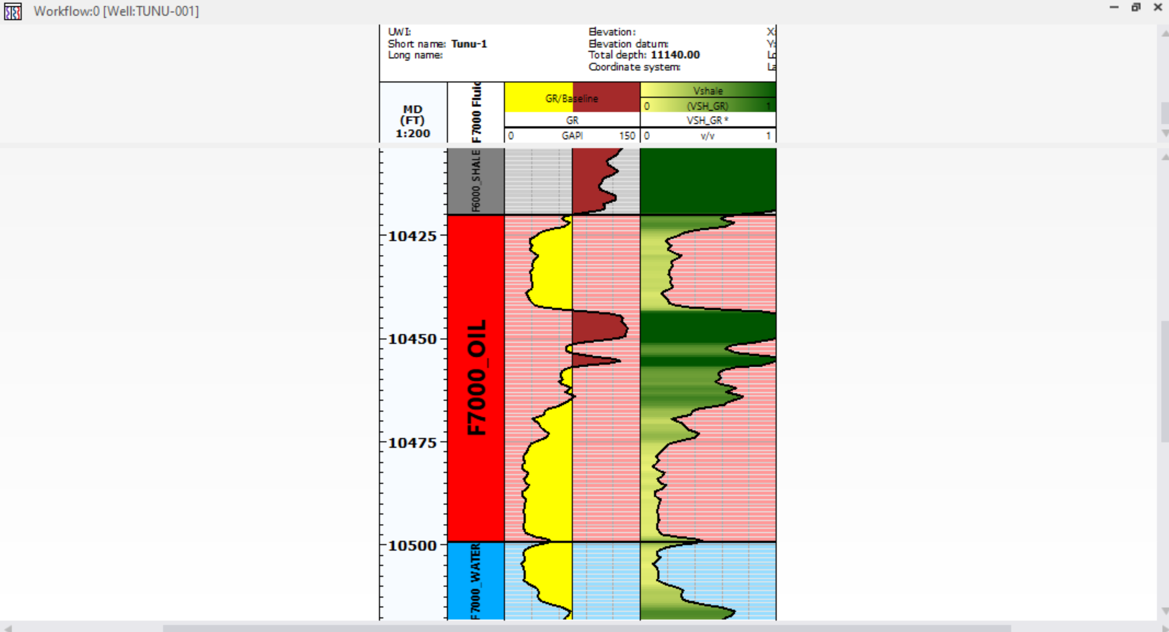
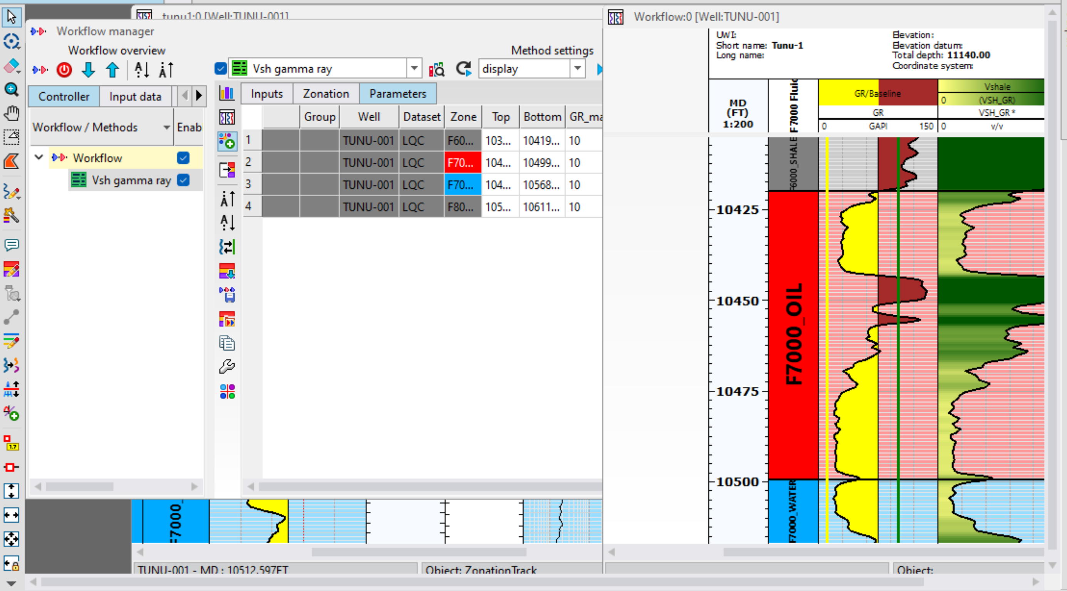
VSHALE ESTIMATION (2)
ON THE GLOBAL ZONATION WINDOW, SELECT THE NEWLY CREATED ZONATION AND SELECT ALL THE ZONES
CLICK ON THIS ICON TO INSERT THE SELECTED ZONES
CLICK PLAY TO RUN THE ESTIMATION
CLICK ON THIS ICON TO DISPLAY ENDPOITS ON THE GAMMA RAY LOG. THIS WAY THE END POINTS CAN BE MANUALLY DRAGGED AND PLACED AT THE PROPER VALUES ON THE GAMMA RAY LOG
RESULT SHOWING VSHALE
GO TO PARAMETERS

Slide 15
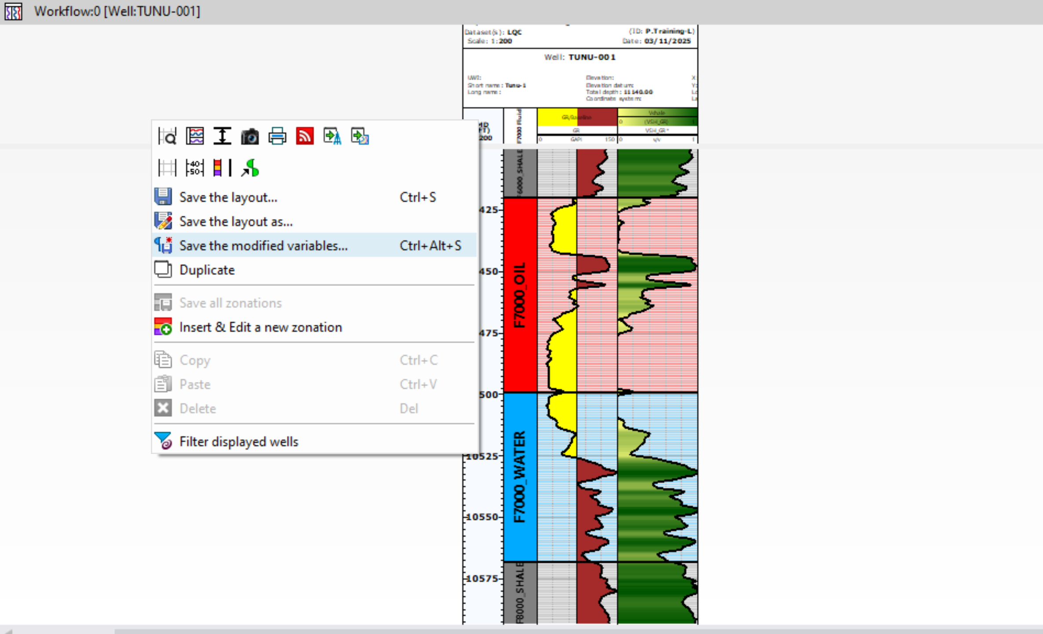
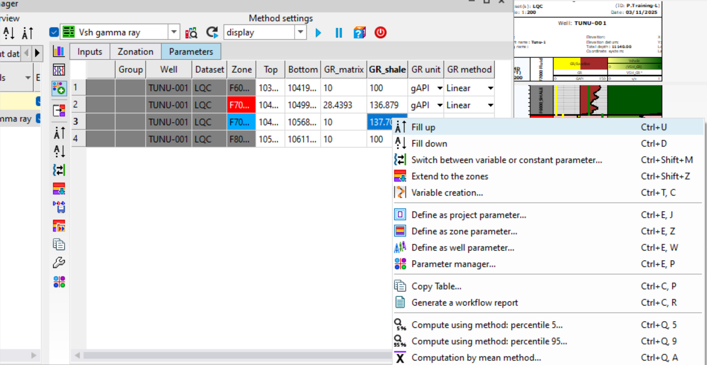
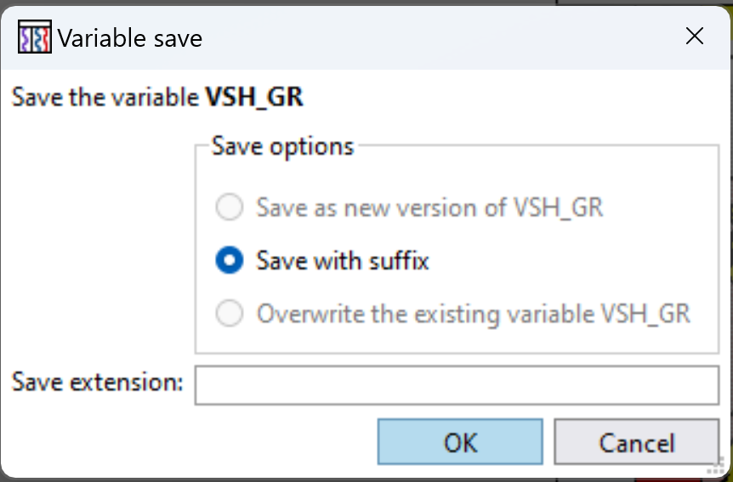
VSHALE ESTIMATION (3)
MAKE SURE THE ENDPOINT VALUES ARE THE SAME FOR ALL THE ZONES
TO SAVE THE VSHALE LOG, RIGHT CLICK ON THE LAYOUT AND SAVE THE MODIFIED VARIABLES

Slide 16
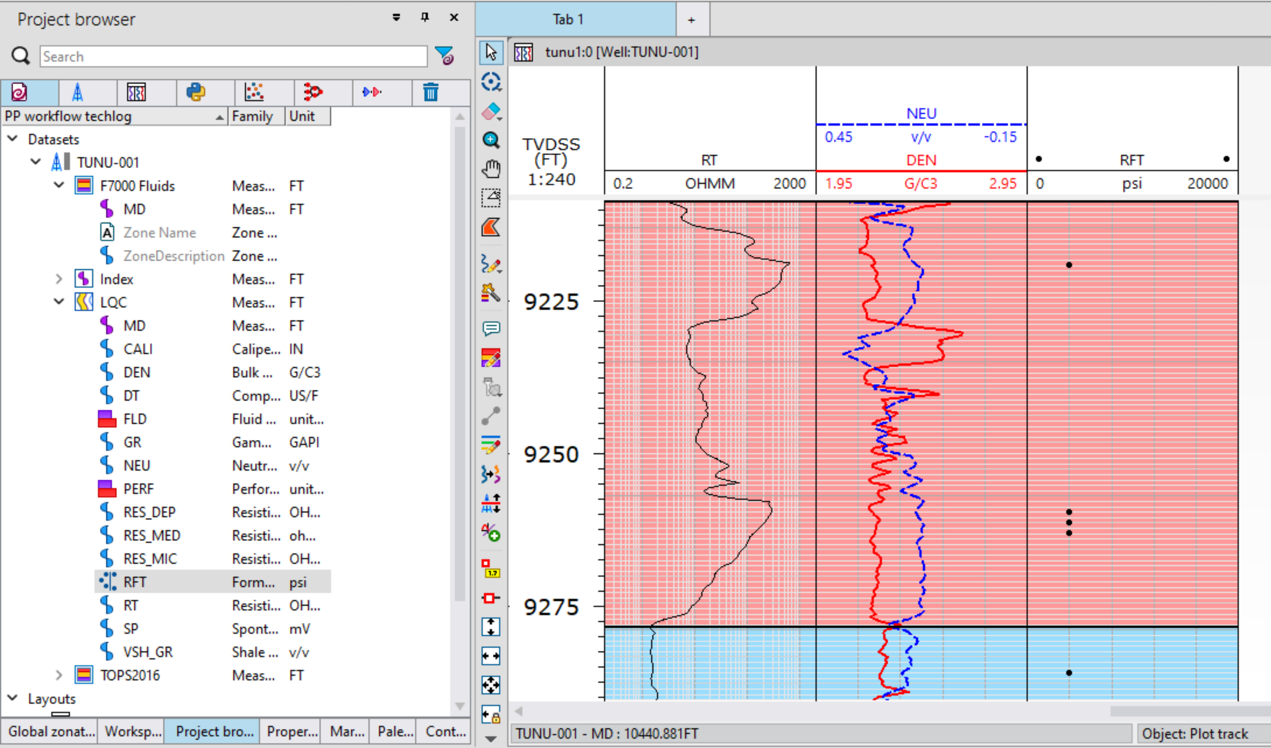
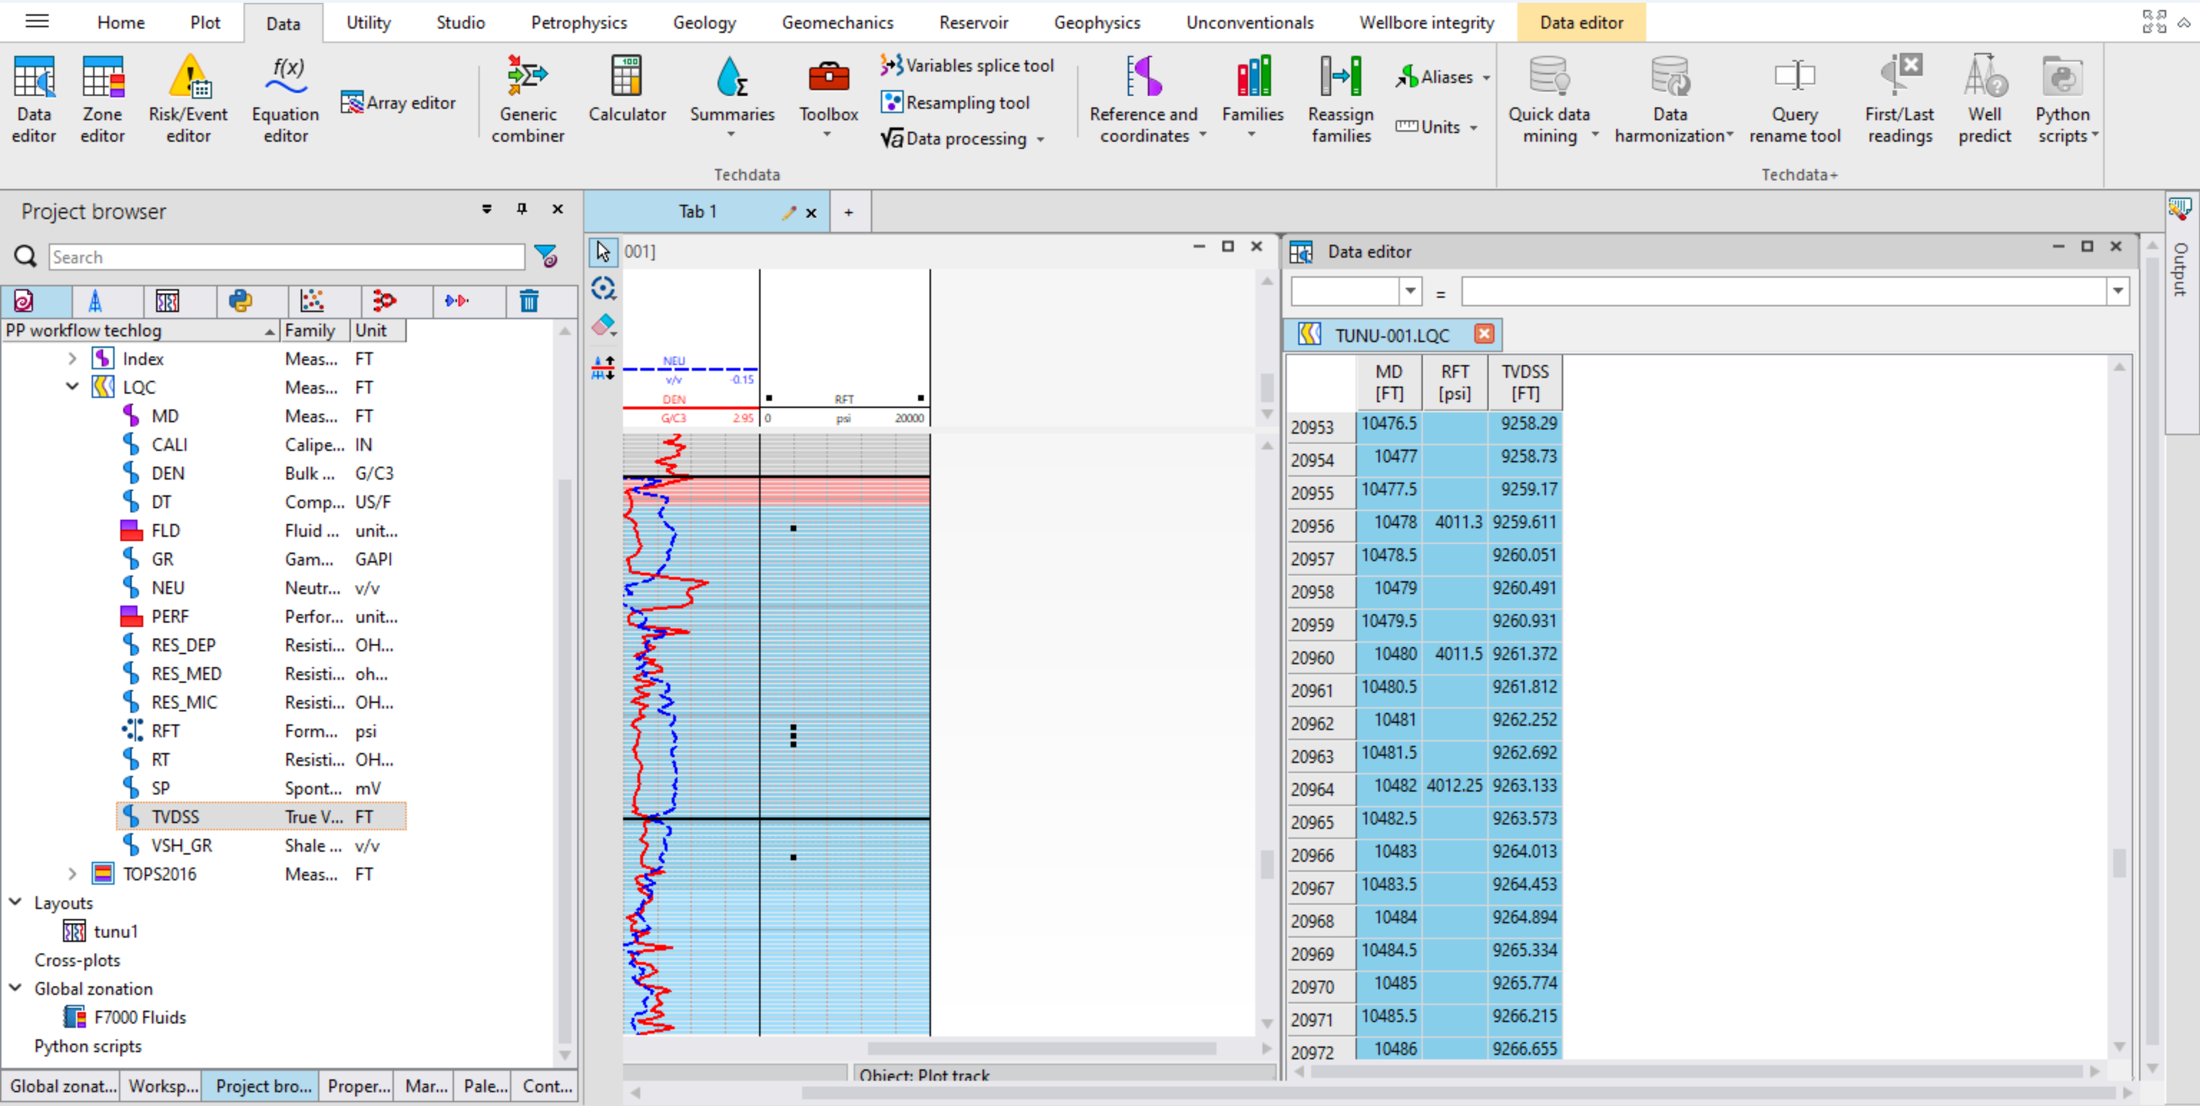
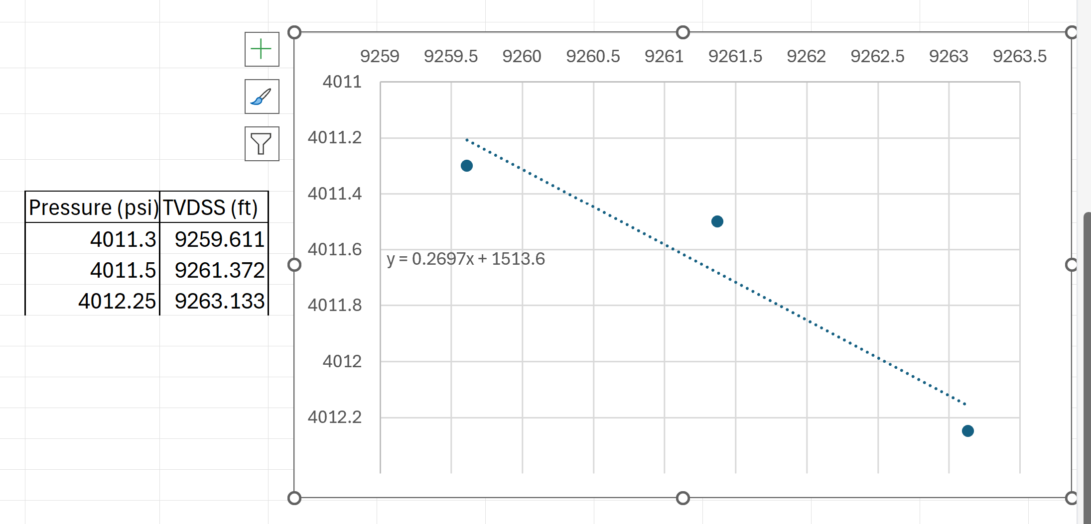
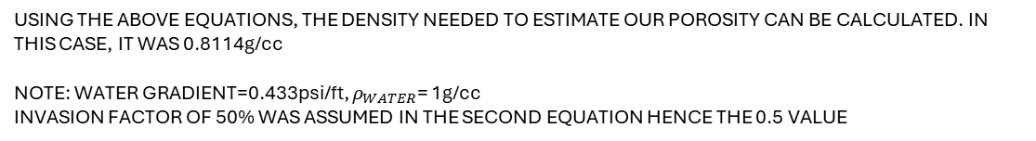

POROSITY [RFT]
DRAG AND DROP RFT LOG AND TVDSS ON DATA EDITOR
HIGHLIGHT THE OIL ZONE SO THE PRESSURE POINTS OF INTEREST SHOW UP ON THE DATA EDITOR
ON OUR WELL LAYOUT, DRAG AND DROP RFT LOG
TRANSFER POINTS TO EXCEL AND PLOT. SLOPE OF EQUATION IS THE OIL GRADIENT
$$ρ_{OIL}=\frac{OIL GRADIENT}{WATER GRADIENT}$$
$${ρ_{FLUID}=ρ}_{OIL}×0.5+ρ_{WATER}×0.5$$
USING THE ABOVE EQUATIONS, THE DENSITY NEEDED TO ESTIMATE OUR POROSITY CAN BE CALCULATED. IN THIS CASE, IT WAS 0.8114g/cc
NOTE: WATER GRADIENT=0.433psi/ft, $ρ_{WATER}$= 1g/cc
INVASION FACTOR OF 50% WAS ASSUMED IN THE SECOND EQUATION HENCE THE 0.5 VALUE

